Slide 1

Rethinking relationship fundraising
Ian MacQuillin
Director
Rogare – The Fundraising Think Tank

Slide 2
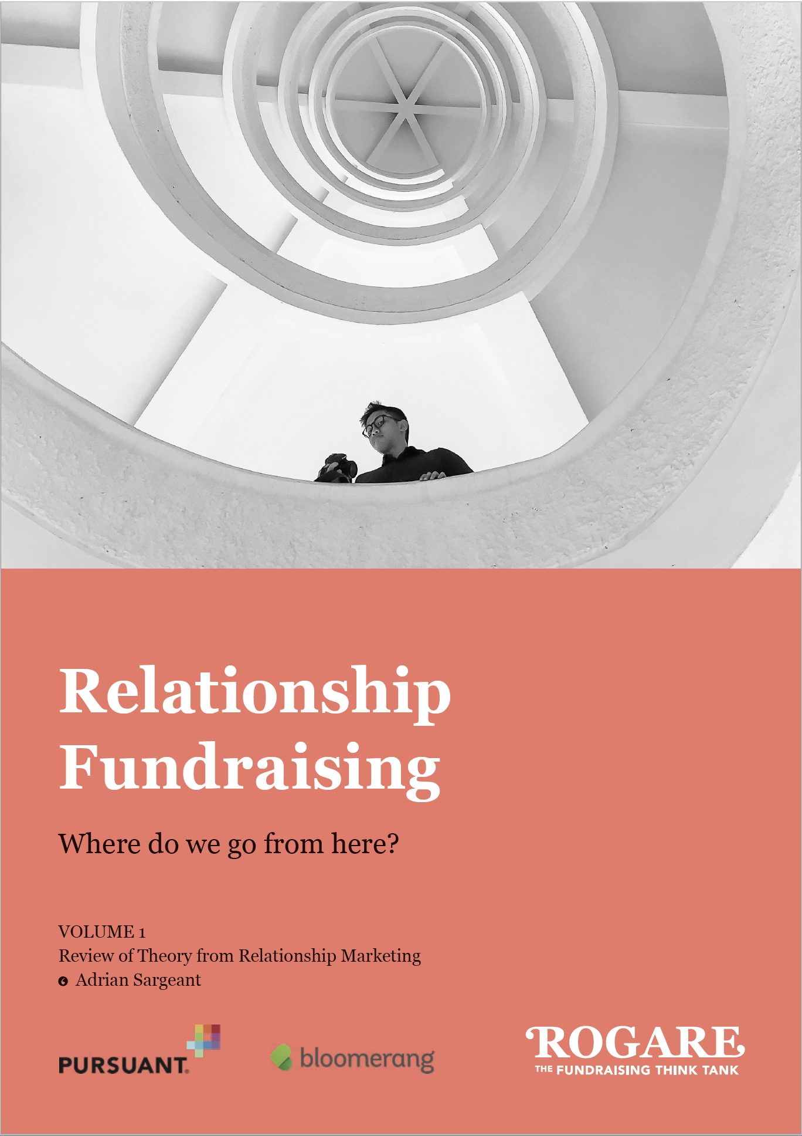
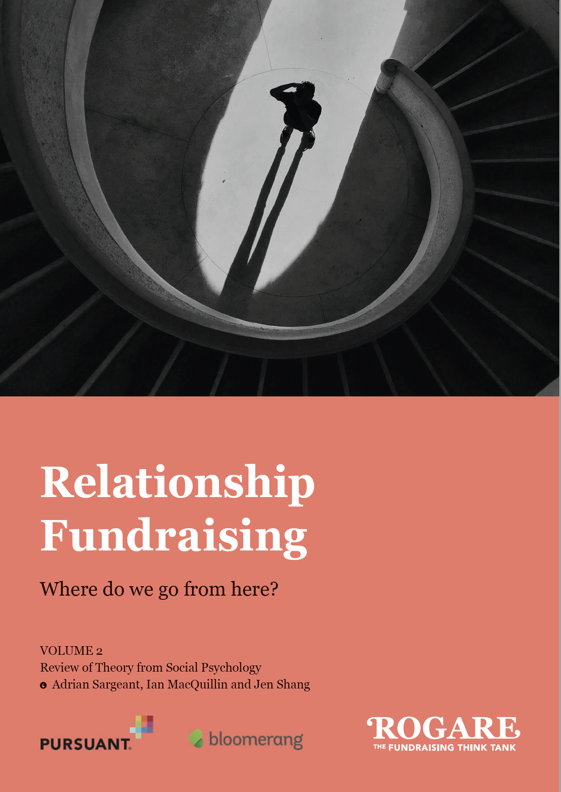
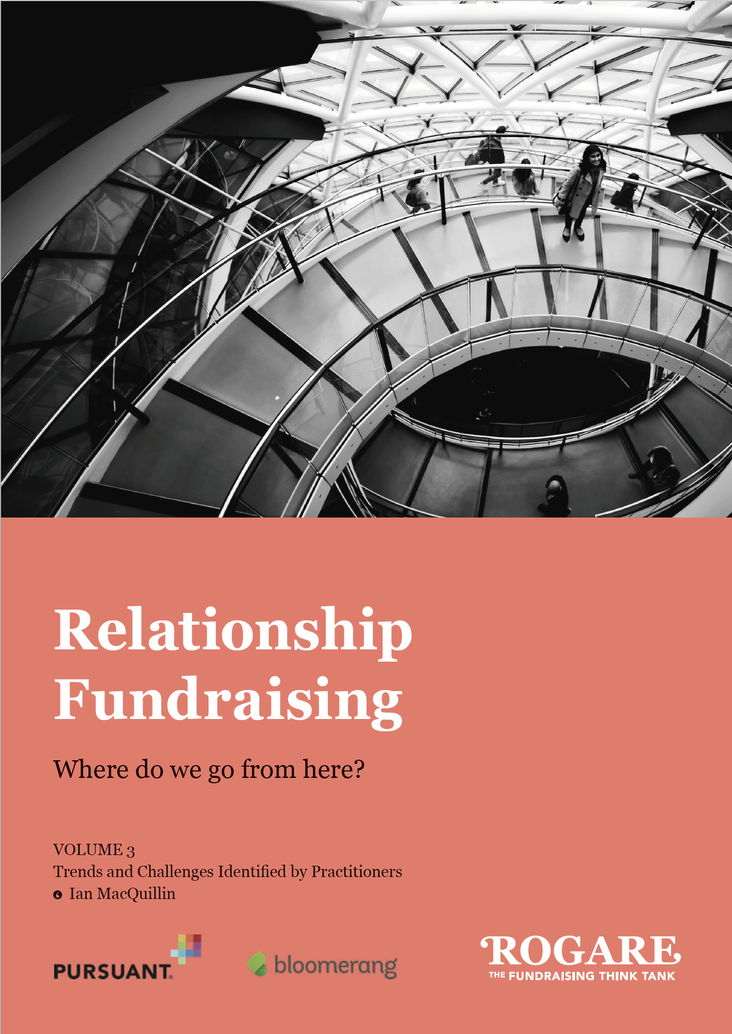
Rogare’s RF project
https://www.rogare.net/relationship-fundraising

Slide 3
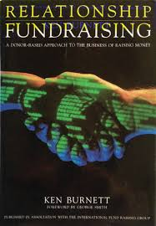
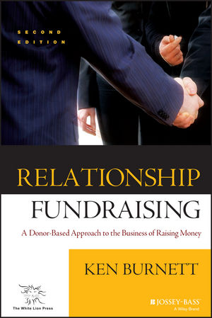
What is relationship fundraising?
Term first used in 1992 by Ken Burnett

Slide 4
What is relationship fundraising?
“An approach to the marketing of a cause that centres on the unique and special relationship between a nonprofit and each supporter.
“Its overriding consideration is to care for and develop that bond and to do nothing that might damage or jeopardize it.
“Every activity is therefore geared toward making sure donors know they are important, valued, and considered, which has the effect of maximizing funds per donor in the long term.”
  Ken Burnett, Relationship Fundraising (2002), p38

Slide 5
Stages of RF
RF 1.0 – Anecdotal stage. Practitioner wisdom and literature. Lots of case studies. ‘Self-evident’ that it works.
RF 2.0 – Theoretical stage. Rogare’s review of the marketing and social psychology theory underpinning relationship fundraising.
RF 3.0 – Enhanced evidence/theory stage. The evidence derived from RF 2.0 theory by the Adrian Sargeant and Jen Shang and the development of philanthropic psychology.

Slide 6
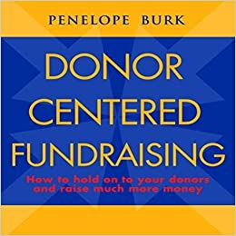
Tenets of RF 1.0
Donor at centre of fundraising
Excellent donor care
Use of second person pronoun ‘you’ in fundraising comms
Donor is the hero
Fundraisers connect donors to a cause.

Slide 7
Relationship fundraising v2.0
Underlying theory
https://www.rogare.net/relationship-fundraising

Slide 8
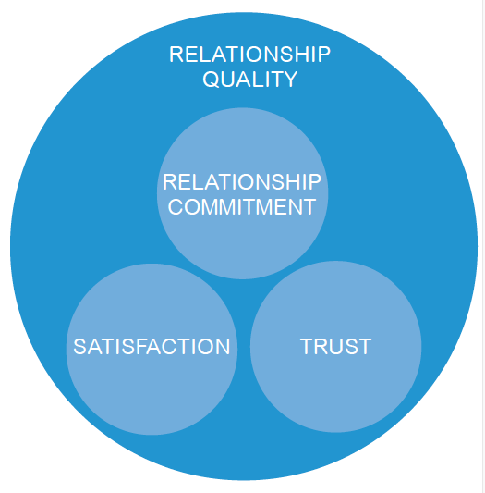
Relationship components
Trust
Commitment
Satisfaction
Loyalty

Slide 9
Social psychology
Attraction
Self-verification and similarity
Intimacy and disclosure
Self-enhancement
Identity
Self-determination

Slide 10
Tenets of RF2.0
Meet donor needs.
At start of relationship (acquisition)…
  …focus on beneficiaries
to deepen relationship (retention)…
  …focus on donor.
Satisfaction drives loyalty and LTV.
  Make donors feel satisfied and money will follow.
Build intimacy in the relationship and strive for a sense of collective identity.

Slide 11
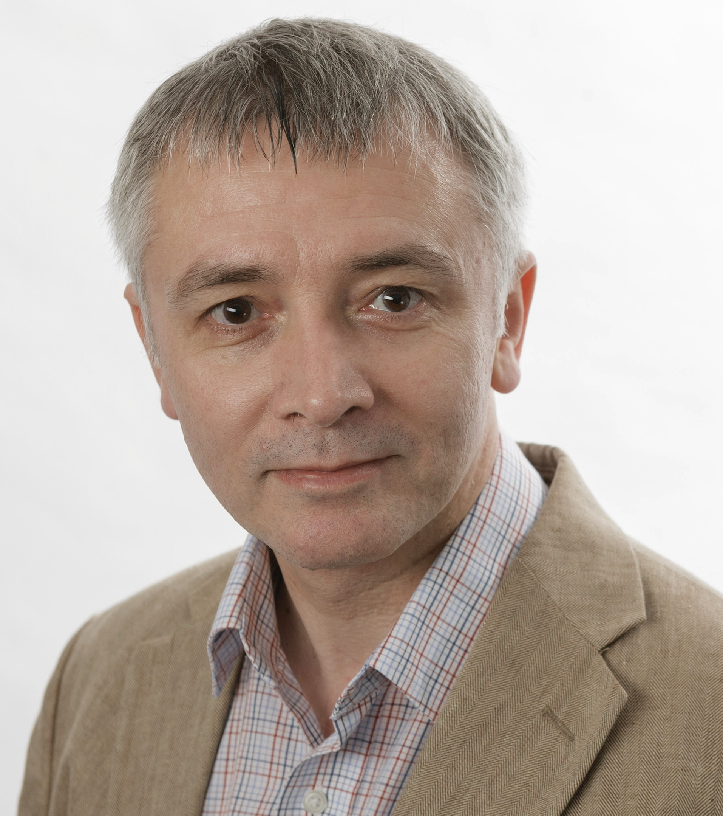

Relationship fundraising 3.0
Or…
Donorcentricity 3.0, or
Philanthropic psychology

Slide 12
Relationship fundraising 3.0
Making donors feel good will lead to greater loyalty and increased support (RF 2.0).
RF 3.0 tells you precisely how to make them feel good and precisely what type of increased support this will lead to.

Slide 13
Tenets of RF 3.0
Identify and understand donors’ needs
Serve those needs
Focus on how fundraisers make donors feel
Philanthropic psychology
  Identity
  Wellbeing
  Love
    https://www.philanthropy-institute.org.uk/blog/philanthropic-psychology-the-101

Slide 14
What does RF 3.0 really mean?
Making donors feel good will lead to greater loyalty and increased support (RF 2.0).
RF 3.0 tells you precisely how to make them feel good and precisely what type of increased support this will lead to.

Slide 15
RF as donorcentred fundraising
“Conventional fundraising positions the charity, the charity’s needs, and the scale of the work done by the charity, at the centre of its fundraising.
“Relationship fundraising, on the other hand, positions the donor at the centre of its fundraising.”
  Giles Pegram https://101fundraising.org/2015/04/the-state-of-relationship-fundraising-a-conversation/

Slide 16
RF as donorcentred fundraising
“Essentially, this is about placing the donor, or prospective supporter, at the heart of all your activities.”
Participant to Rogare’s qual research on RF
https://www.rogare.net/relationship-fundraising

Slide 17
RF as donor-centred fundraising
“An ethical belief in the importance of the donor” that “recognis[es] that the donor comes first…always putting the donor first in regard to when to ask, how to ask and what to ask for.”
  Geever 1994 (Full reference in Rogare ethics white paper).

Slide 18
RF as donor-centred fundraising
“Donors are the most important people in the entire charity process.”
Direct Marketing Association

Slide 19
RF as donor-centred fundraising
Is relationship fundraising the same thing as ‘donor-centred’ fundraising?
Yes and no.
  All donor-centred fundraising is (probably) relationship fundraising
  Not all relationship fundraising is necessarily donor-centred.

Slide 20
RF 4.0 – non-donorcentred
Can the next state of the evolution of relationship fundraising be one that de-centres the donor?

Slide 21
RF 4.0 – non-donorcentred
Ethical issues
Donor dominance
Critique from Community-centric Fundraising

Slide 22
Intra-organisation relationships
“One major weakness of relationship fundraising is that the governing board and leadership volunteers are not sufficiently engaged in the process.
North American consultant

Slide 23
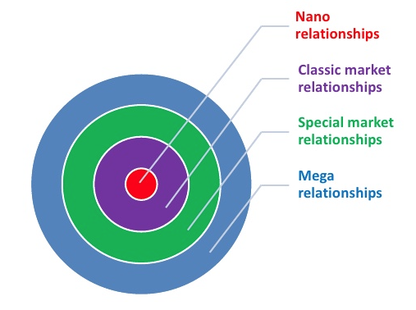
Total Relationship Marketing
Classic market relationships
Special market relationships
Mega relationships
Nano relationships
Gummesson, E. (1999) Total Relationship
Marketing. Oxford, Butterworth-Heinemann.
https://criticalfundraising.com/2016/06/17/opinion-refashioning-relationship-fundraising-its-about-more-than-just-donors/
Notes:
Very brief intro to the project based on into to our research reports

Slide 24
Total Relationship Fundraising
Fundraisers cannot maintain a narrow focus on the donor if the relationships they neglect, such as with their agencies, or colleagues, result in, or contribute to, a diminished donor experience.
Total relationship fundraising is putting in place, maintaining and servicing all the relationships that enable money to be raised.

Slide 25
Total Relationship Fundraising
Excellent fundraising leaders spend about 50 per cent of their time advocating for fundraising within their organisations
  Sargeant and Shang (2012). Great Fundraising Report.

Slide 26
Total RF/Balance Theory
The role of relationships fundraising could also be to ensure stakeholder relationships are appropriately ‘balanced’.
Balance Theory (Fritz Heider)

Slide 27
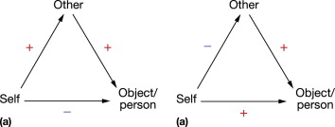
Balance Theory
Relations are represented by a ‘triad’, graphically represented by a triangle

Slide 28
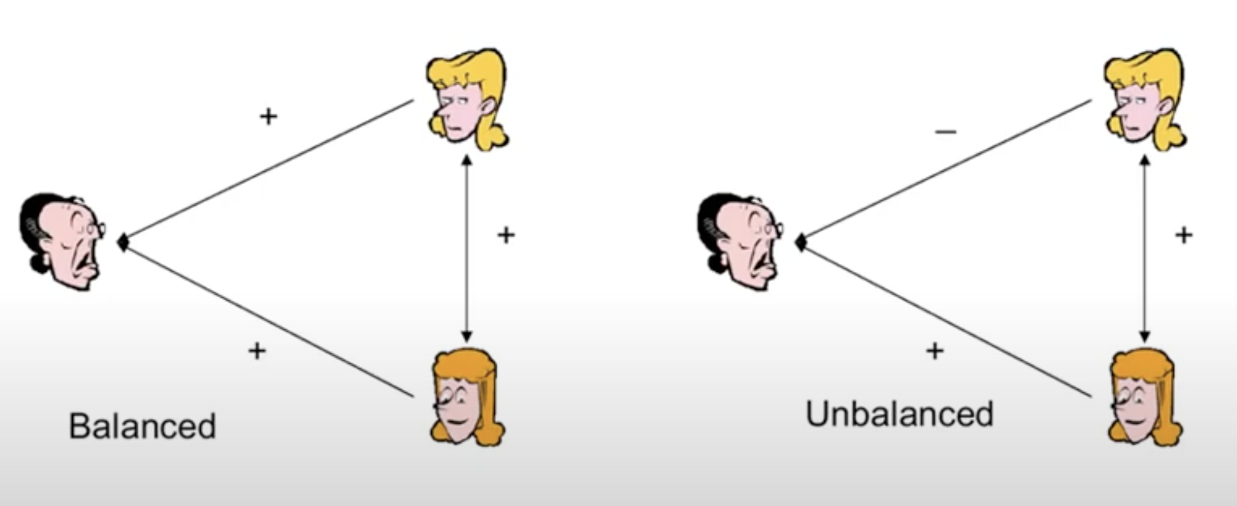
Balance Theory

Slide 29
Balance Theory
https://www.telegraph.co.uk/news/health/news/9194173/Local-fundraisers-boycott-cancer-charity-over-chuggers.html

Slide 30
Total RF/Balance Theory
Analysing fundraising relationships using Balance Theory helps us see where and why relationships are failing and what we can do to fix them.
  https://criticalfundraising.com/2016/07/20/opinion-a-balancing-act-applying-total-rf-to-all-donor-relationships/

Slide 31
Incorporating CCF principles
CCF says fundraisers ought to have “difficult conversations” with donors about their giving, and how this sits in the context of their power and privilege.
Perhaps the best people to do this are donor-centred, relationship fundraisers who already understand the donor needs and the psychology of giving.

Slide 32
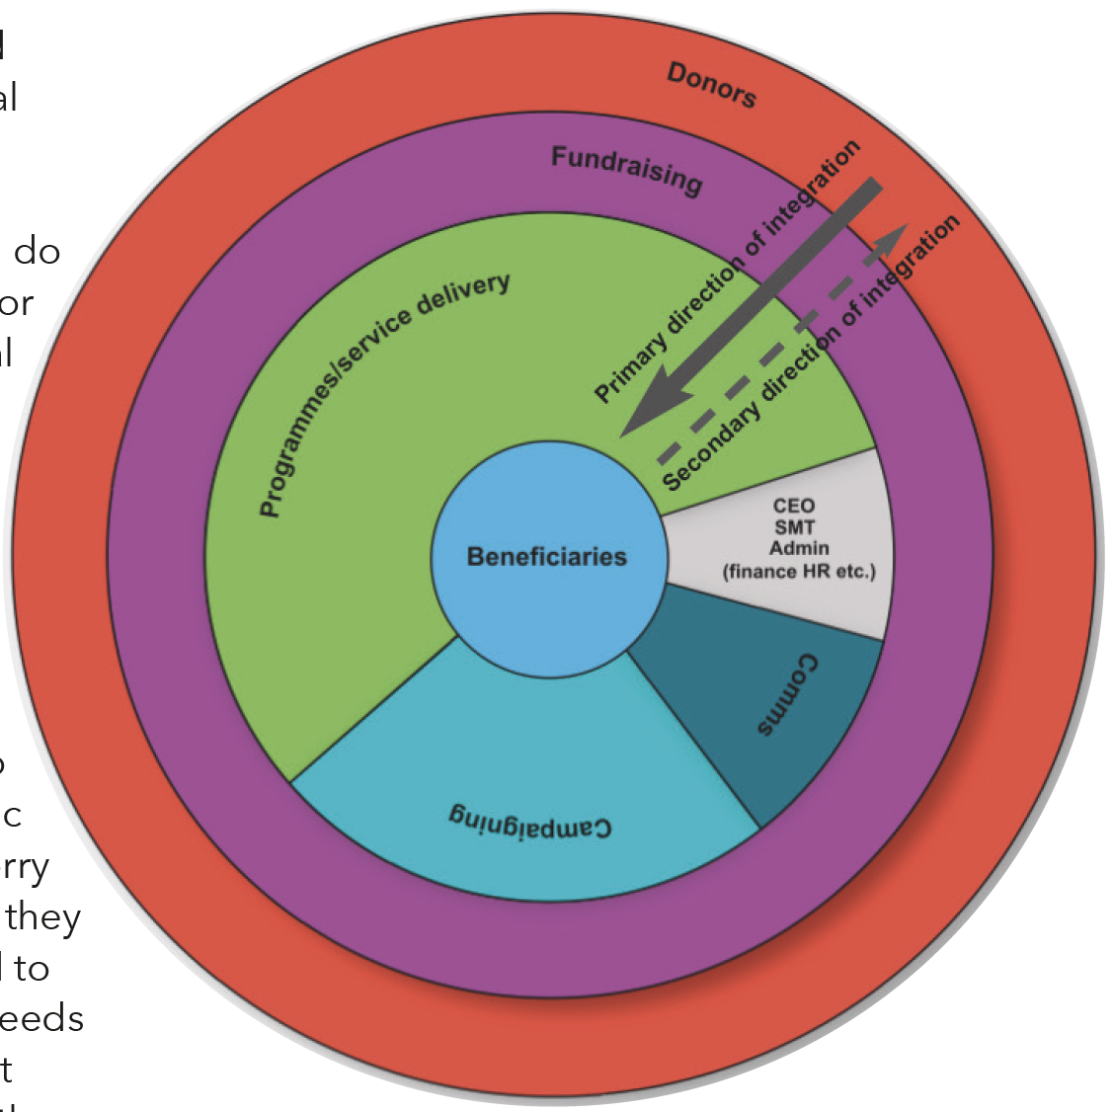
Incorporating CCF principles
Integrative fundraising
https://criticalfundraising.com/2018/08/13/new-ideas-how-to-put-beneficiaries-first-without-throwing-donors-out-with-the-bathwater/#more-28

Slide 33
RF as care ethics
Care ethics give us an opportunity to totally rethink the whole notion of ‘relationship’ fundraising, both its practice and ethics.

Slide 34
New directions for RF
Customer experience » donor experience
Customer brand engagement » donor brand engagement
The theory of managing Organisation-Public Relationships (OPRs) from public relations
Virtual relationships and those managed by artificial intelligence
A postmodernist approach to donor-centred fundraising and storytelling
Relationships with non-human subjects.

Slide 35
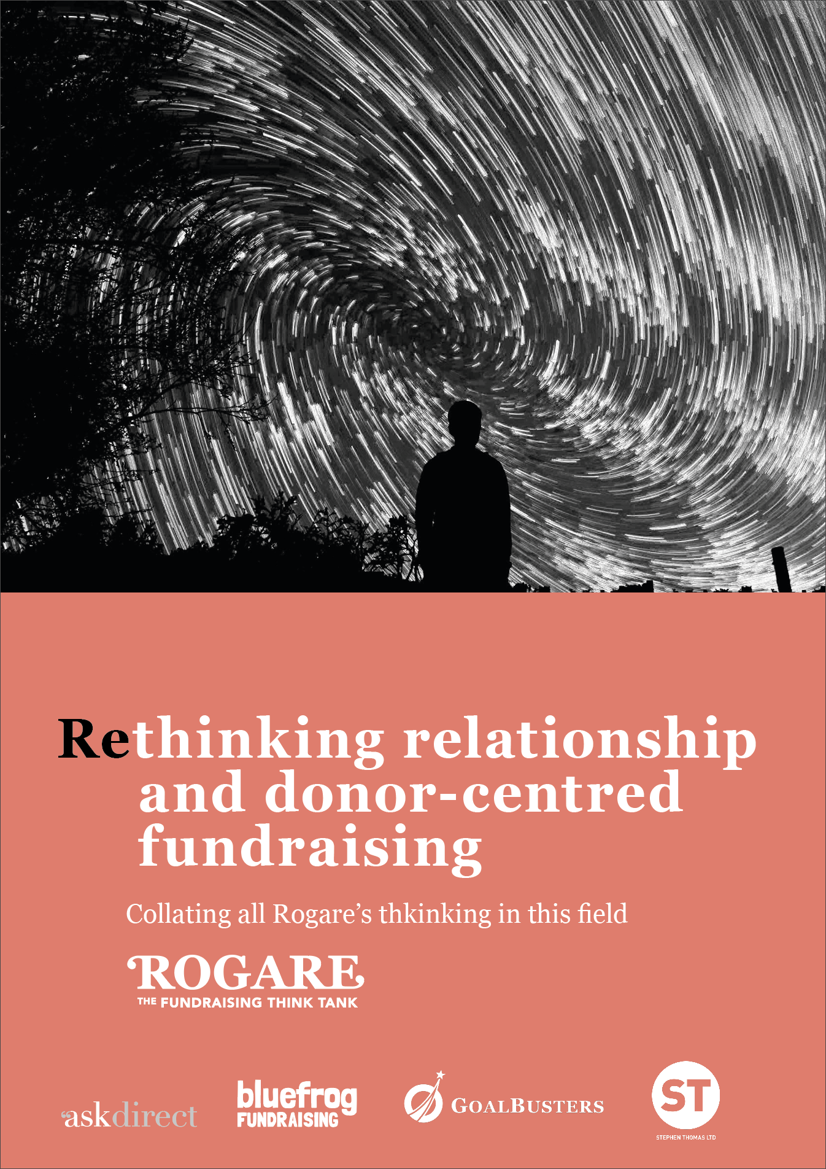
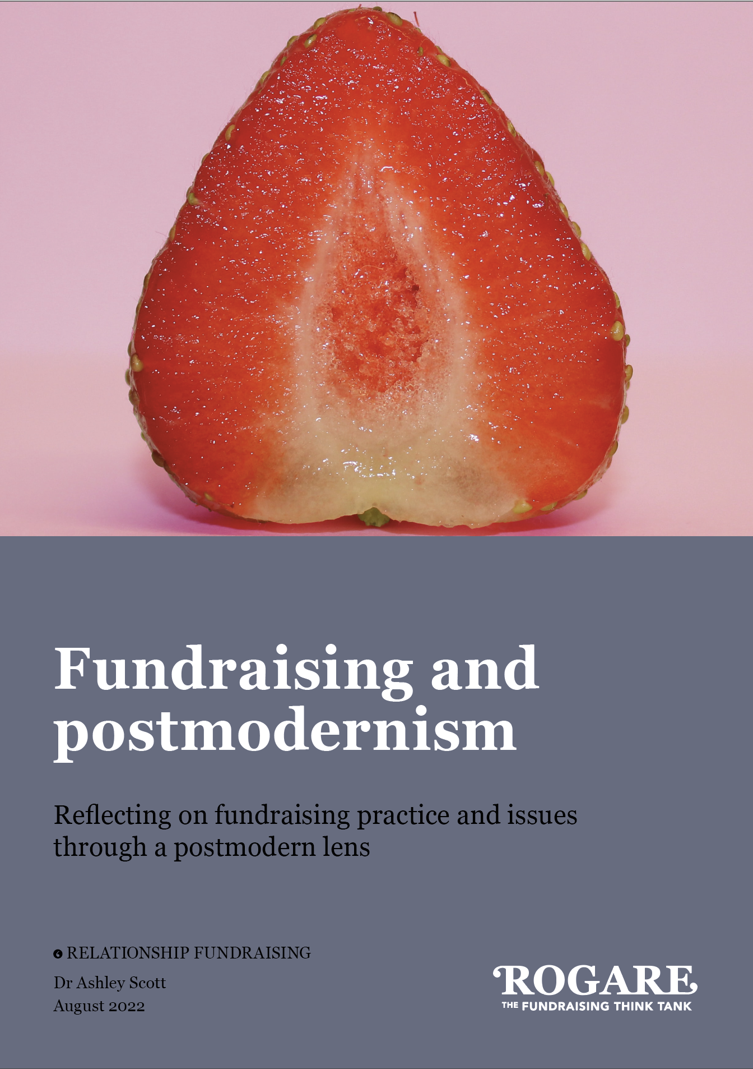

Slide 36




Rogare Associate Members
Rogare is supported in our work by a number of Associate Members – partners to the fundraising sector that share our critical fundraising ethos. It is because of this support that we can make all our work freely available to the fundraising profession.

