Slide 1

Ethics of framing
Jess Crombie
London College of Communication, UAL

Slide 2
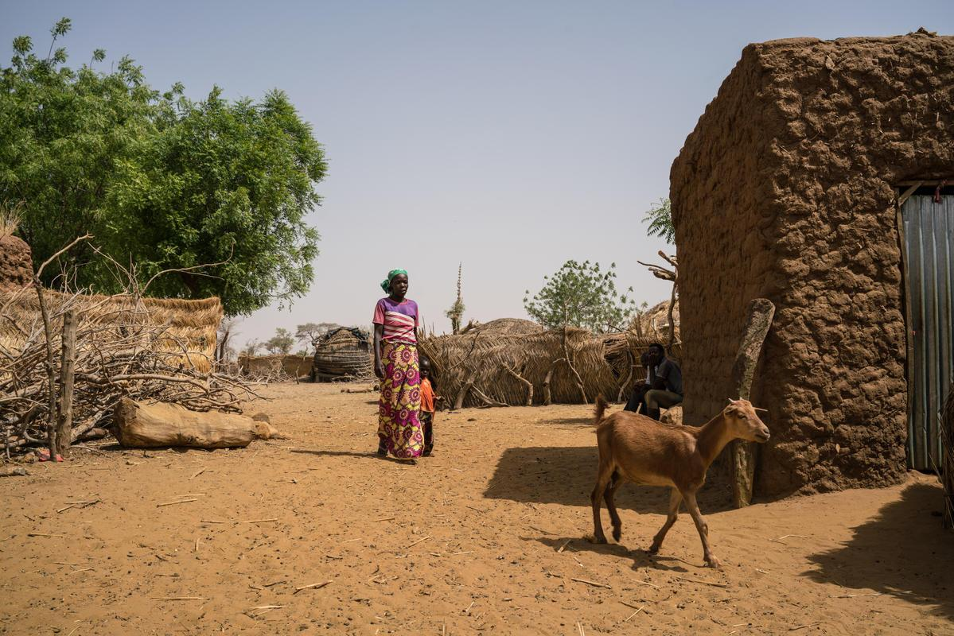
“The sweetest songs”
Notes:
The title of this paper came from a piece of research called the People in the Pictures that I carried out with Siobhan Warrington and published in 2017. In this research we interviewed over 200 people in Niger, Bangladesh, Jordan (Syrian refugees) and the UK who had appeared in Save the Children’s content and their close communities and asked them about the process of sharing their stories, their motivations and what they thought about their final portrayal in fundraising and communications materials. In Niger (in a location not unlike that in this image) almost everyone we interviewed quoted this local proverb which translates as ‘a songs sounds sweeter from its author’s mouth’. What they meant was what we heard from everyone across all four countries - we want to share our voices, not just our literal voices, but voice as in agency - having decision making power on what story is told, and how.

Slide 3
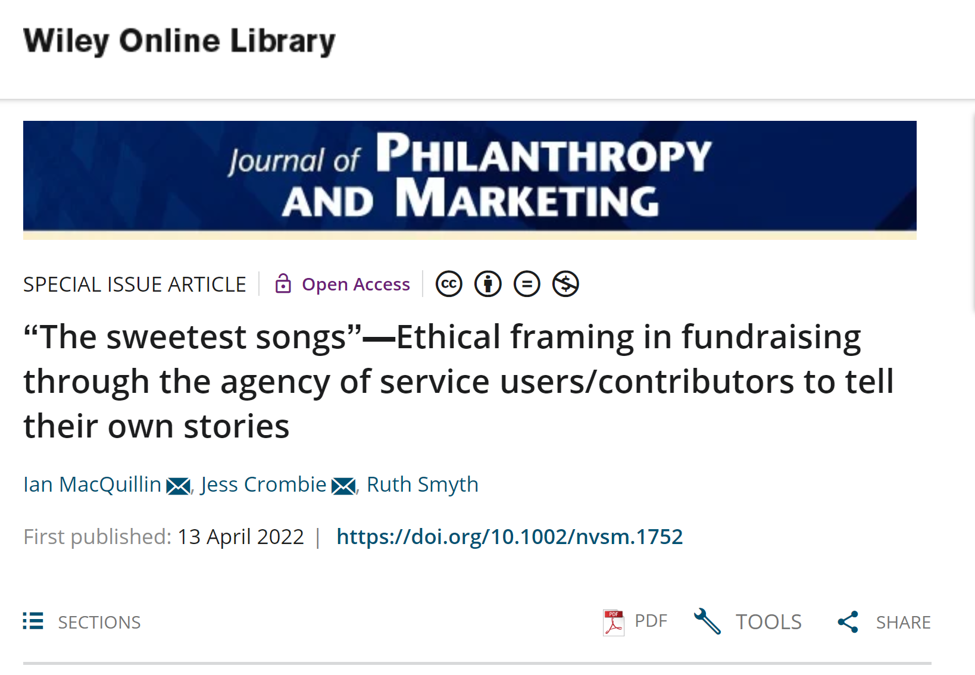
Notes:
I have spent my career all over the world gathering stories from people in all types of circumstances, and I’ll be honest, what we found out during the PITP wasn’t a surprise. But it was good to have it evidenced, because what it allowed was a new way to start thinking about the ethics of fundraising in the development sector.
It also inspired this new paper, co-written by myself, Ian McQuillan and Ruth Smyth. In this paper we develop and deliver a new way of thinking about ethical framing. Up until now, much of the discussion on the ethics of the framing of service users in fundraising and marketing materials focuses on the ethical dilemma of whether the means of using negative framing and negatively-framed images —which it is argued are more effective at raising money—justify that end if they cause harm by stereotyping and “othering” the people so framed, rob them of their dignity, and fail to engage people in long-term solutions.

Slide 4
Framing ethics
FUNDRAISING FRAME
VALUES FRAME
Notes:
These ideas have been well laid out by Rogare around what Ian has termed Rights Balancing Fundraising Ethics. This centred around the development of two named ‘frames’ - way of referring to this debate.
In the simplest terms, the Fundraising Frame is the argument that we need to raise money, and certain images and stories so this better than others. And the Values Frame is that by telling these stories at all you are creating racist, derogatory stereotypes and so certain images and stories should never be shown/told.
As Ian and colleagues at Rogare have previously argued, both of these views, which certainly true, are also at an entrenched stalemate, one that has been going on for decades.

Slide 5
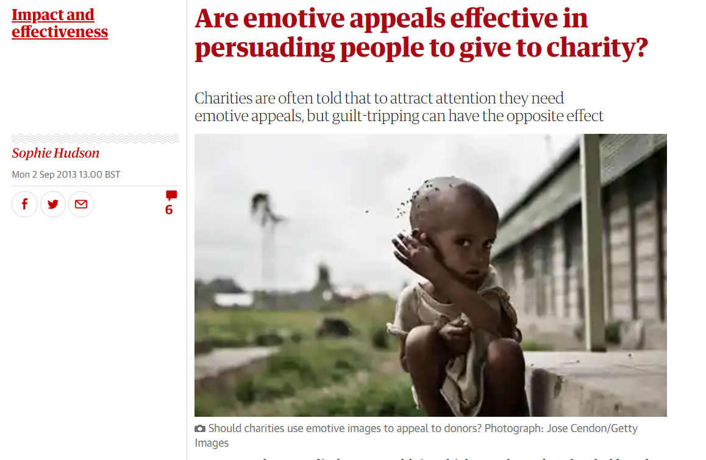
Notes:
As we know, the debate has largely centred around what, or what not to show, with images of malnutrition on the continent of Africa as a spotlight. And attempts to find a balance between these two ethical poles (on the one hand it is unethical to show images such as this, and on the other hand it is unethical not to be able to raise money needed for programmes) have proved elusive.
This is a Guardian article from 2013, and to go even further back, the term poverty porn was coined back in 1981 by UNDP staffer Jordan Lissner in his paper ‘Merchants of Misery’.

Slide 6
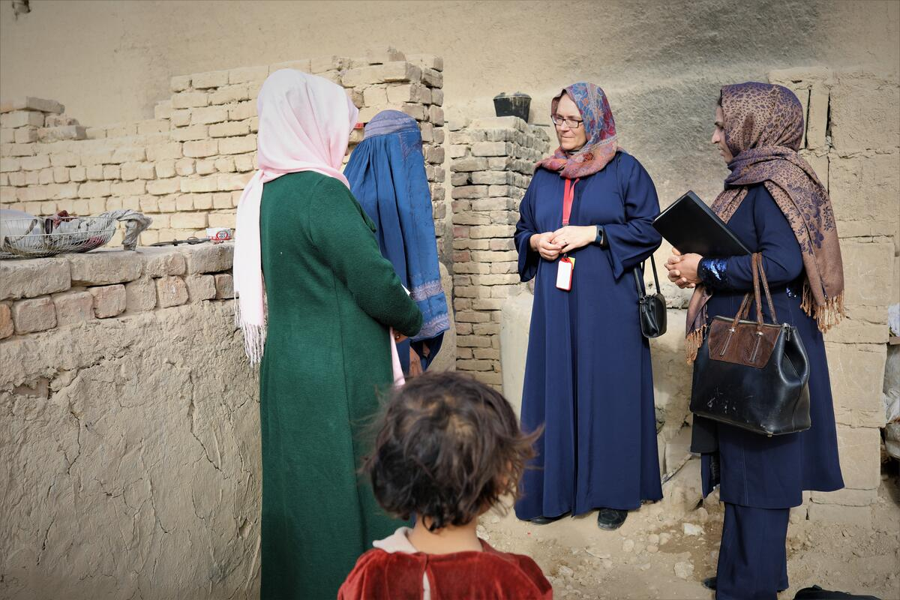
Notes:
What we are attempting to provide with this paper, is a new ethical solution based in the process of story gathering and telling. Instead of fundraising and communications professionals deciding what is ethical to show or not show on behalf of the people in the stories, we instead propose that the ethicality of fundraising frames are contingent on the voice and agency of service users/contributors to tell their own stories and contribute to their own framing: as the Niger proverb says, “a song sounds sweeter from the author's mouth.”
This is about including a new decision making voice - that of the contributor, service user beneficiary - whatever term you prefer - themselves.

Slide 7
Framing ethics
Voice
  The ability to participate in deliberative processes
Agency
  Socially-produced and culturally-generated ability to act in specific spaces, providing a choice to act in a way that makes a pragmatic difference

Slide 8
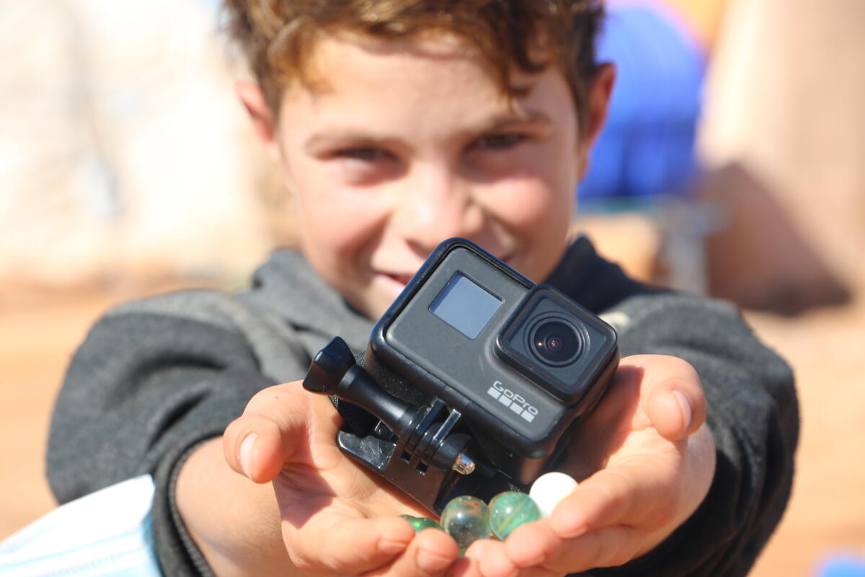
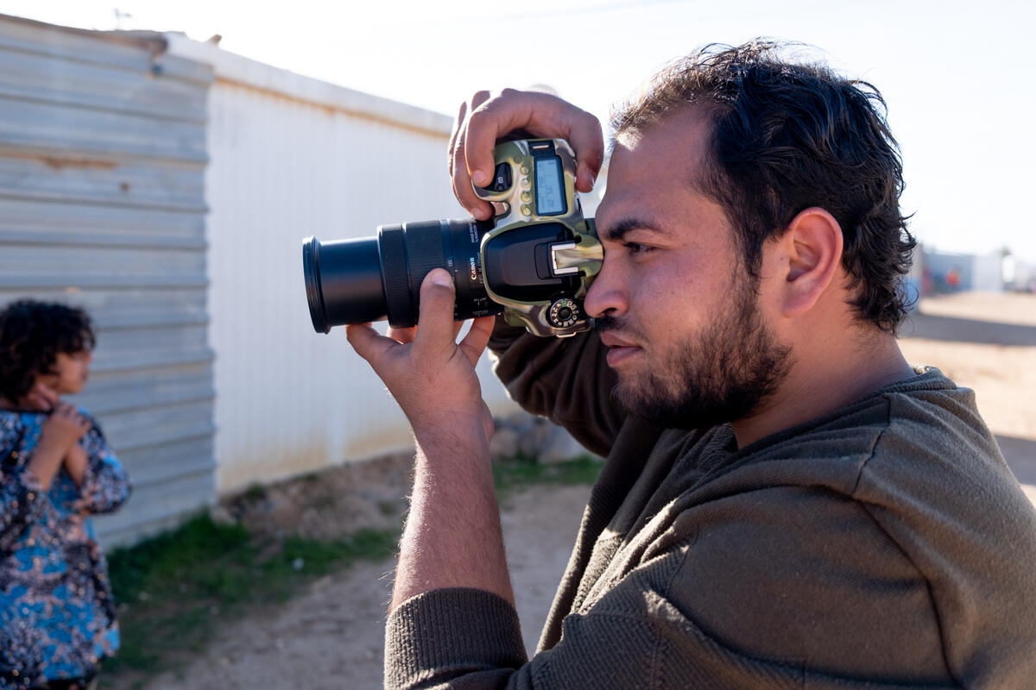
Notes:
This will be contingent on some shifts in working practises.
It’s not about what is sometimes referred to user-generated content, although this can be included. Samir, in Idlib.
It is not also about hiring local people to gather stories, although that can also be helpful. This is Samer, he is a Syrian person living as a refugee in Zaatari Refugee Camp. As part of camp activities he learned how to be a photographer, and is now pursuing it successfully as a career.
Instead it is about sharing editorial decision making power. As this is what contributors have been telling me that they want for the entire of my career.

Slide 9
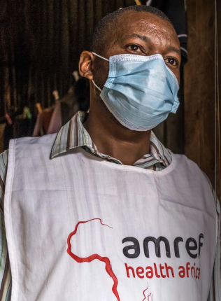
“I feel appreciated that we came with a story about my community, I am the one who developed a story, rather than the world telling my stories.”
Patrick Malachi –Who Owns The Story?
Notes:
This is a quote from my most recent research - Who Owns The Story - from Patrick Malachi, a community health worker with Amref who was invited to entirely control a fundraising pack for one of the charity’s quarterly appeals. We put it head to head in a blind test against a pack editorially controlled by Amref. Not only did the pack created by Patrick raise more money, but donors proactively communicated that the fact that it was created by Patrick was one of the reasons that made them more likely to give larger amounts - more authentic and less steeped in old stereotypes (quotes from middle aged white folk in the home counties no less).

Slide 10
How to deliver this?
Invest in creative and collaborative approaches to image making.
Uphold contributor’s rights and fulfil the duty of care.
Informed consent to be understood as a process with clear procedures in place.
Commit to sensitive and effective communication before, during and after image-gathering.
Ensure that human dignity is upheld in the image making process, not just in the image itself.
Notes:
We have a set of recommendations, these are taken from The People in the Pictures, and I have been testing these in my work since 2017 and they are very achievable.

Slide 11
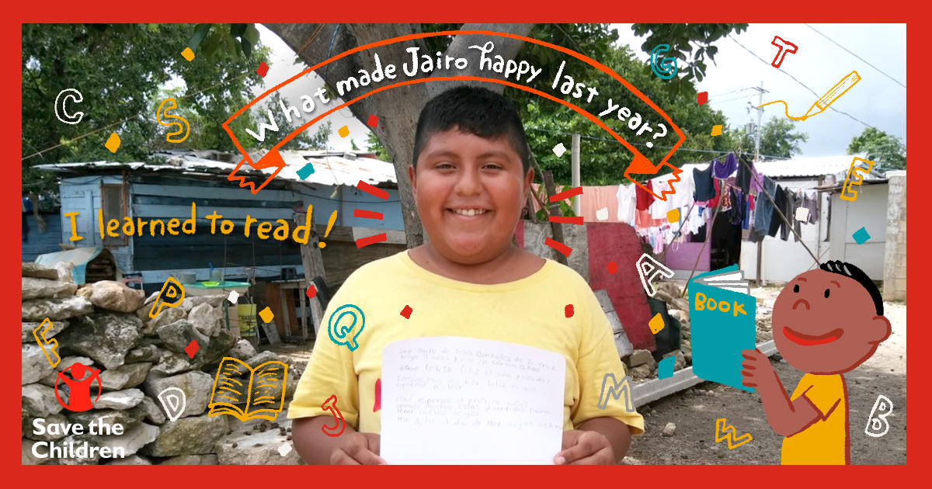
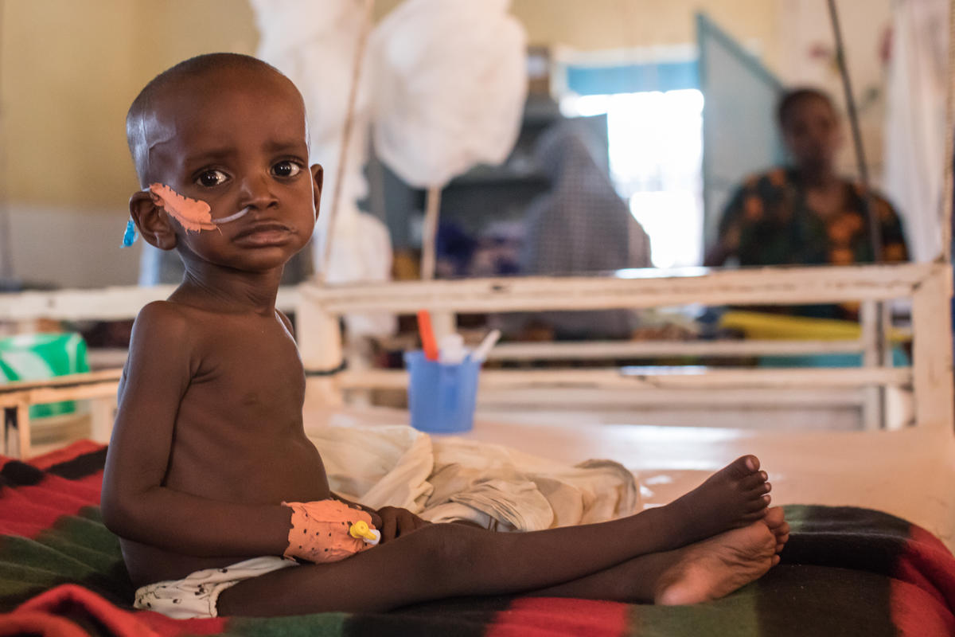
Notes:
This doesn’t mean that all stories will end up looking like this - positive - or that we will never show images like this on the right, again.
Instead it means that the process of gathering stories will shift, to prioritise the agency of the contributors to their own stories.

Slide 12
Ethics of framing
“Framing in fundraising is ethical when it provides a way for service users/contributors to use tier voice and agency to contribute to their own framing and telling of their own stories, and unethical when it does not.”

Slide 13




Rogare Associate Members
Rogare is supported in our work by a number of Associate Members – partners to the fundraising sector that share our critical fundraising ethos. It is because of this support that we can make all our work freely available to the fundraising profession.

