Slide 1

Overcoming donors’ silent resistance to taboo causes
David Harrison
Blind Veterans UK
Notes:
Introduction

Slide 2



Change over time
The number of people who self-report giving to charitable organisations are down year-on-year (CAF, 2021)
Fewer people are giving, but those who are donating are giving more, at £11.3b in 2020-2021 (CAF, 2021)
From an acquisition of new donors perspective, we need to work harder to develop strategies to encourage individuals to acknowledge an organisation’s importance, need and relevance to them
Notes:
Charities Aid Foundation (CAF) - State of giving report 2021

Slide 3
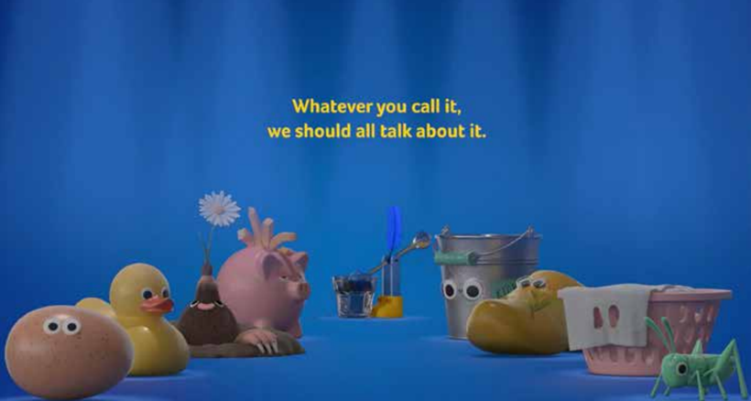
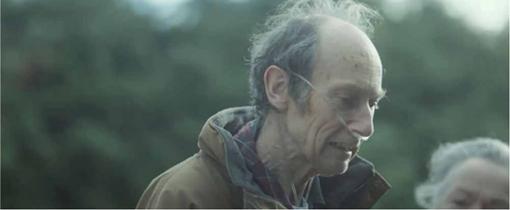
Change over time
From an acquisition of new donors perspective, we need to work harder to develop strategies to encourage individuals to acknowledge an organisation’s importance, need and relevance to them
At the same time we’ve seen a marked change in how organisations communicate their cause away from emotional punch, to more positive, open strategies.

Slide 4
Research Methodology
6 hours of interviews with 5 individuals at Marie Curie
Those selected for interview had strategic overview of external campaigns for different audiences
Visual analysis of 4 case studies, campaigns between 2013 and 2019
Analytical lens for coding; Acceptance and Commitment therapy.

Slide 5
Silent Resistance: Taboo
Silent resistance is where the receiver cannot acknowledge, consider, or act on a communication because the cause communicated is so painful or unthinkable (taboo) that it causes a distancing reaction
Taboos draw behavioural regulatory power from the element of ‘risk’ from violating the taboo – and cause distancing reactions (Bataille, 1962)
Visceral reactions are a “result of nearness, of proximity…and catch our attention almost completely” (Pelzer 2002, p846)

Slide 6
Silent Resistance: the responses
Inflexible response: apathy
Inflexible response: blaming the brand
Inflexible response: bewildered confusion
Inflexible response: Superficial action
“We had a sentence that said, ‘death is inevitable’ [in TalkAbout]. And that kind of bluntness really turns people off.”
“But it's just too hard to use [‘death’] when people are having dinner in front of the TV or when it's completely out of the blue, out of context. You need to manage people's emotional response”

Slide 7
Overcoming Silent Resistance?
3 proposed strategies
Deliteralise cause
Clarify Values
Create Hope
“...humour is a deliberate attribute of the TalkAbout campaign. Because if you can shift something from ‘I didn't want to talk about it at all’ to ‘that made me smile’. You opened a different gateway to a different conversation”
“...[TalkAbout is] talking about a much more forward-facing mission of changing the way people behave, talk about and think about death and the end of life. So that creates a new set of challenges, but also a new set of opportunities

Slide 8
‘Bounce off’ the taboo: short term gain
Short term gain
Reduces attitudinal change
“In an emergency appeal, and you are looking for fast response, and cut through. And so you are using signals shortcuts, and signposts and emotion… that will always work. And what we needed for the emergency appeal to do was raise money now”
“One motivation for people giving to a difficult cause is because I want to make it go away. ‘I don't want to talk about it. I don't want to understand it. I don't want to fix it. But I just know that if I give you a tenner now, I can just park it, and I don’t have to think about it anymore. Go away. I'm done’.

Slide 9

Balancing
Apathy
Deliteralise cause
Confusion
Bounce off the taboo
Clarify values
Blame
Create hope

Slide 10
Conclusions
Overall, research aimed to investigate how Marie Curie encourages people to acknowledge death and dying.
Marketing managers have had to find novel new windows to tell this story.
Further research needed, and more awareness, of the resistance taboo’s cause, and the potential value in looking outside of fundraising to find answers.

Slide 11




Rogare Associate Members
Rogare is supported in our work by a number of Associate Members – partners to the fundraising sector that share our critical fundraising ethos. It is because of this support that we can make all our work freely available to the fundraising profession.

