Slide 1

Fundraising historiography
Ian MacQuillin
Director
Rogare – The Fundraising Think Tank

Slide 2
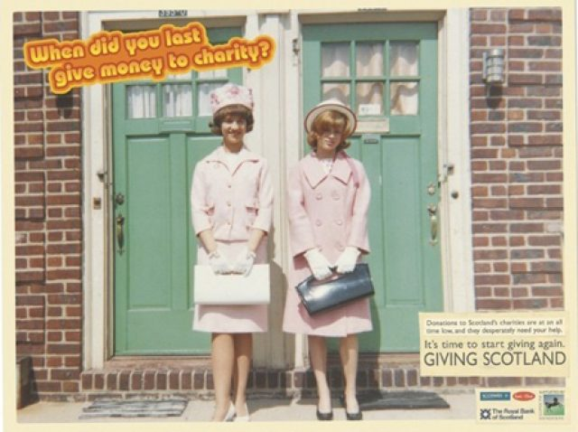
Who knows what this is?

Slide 3
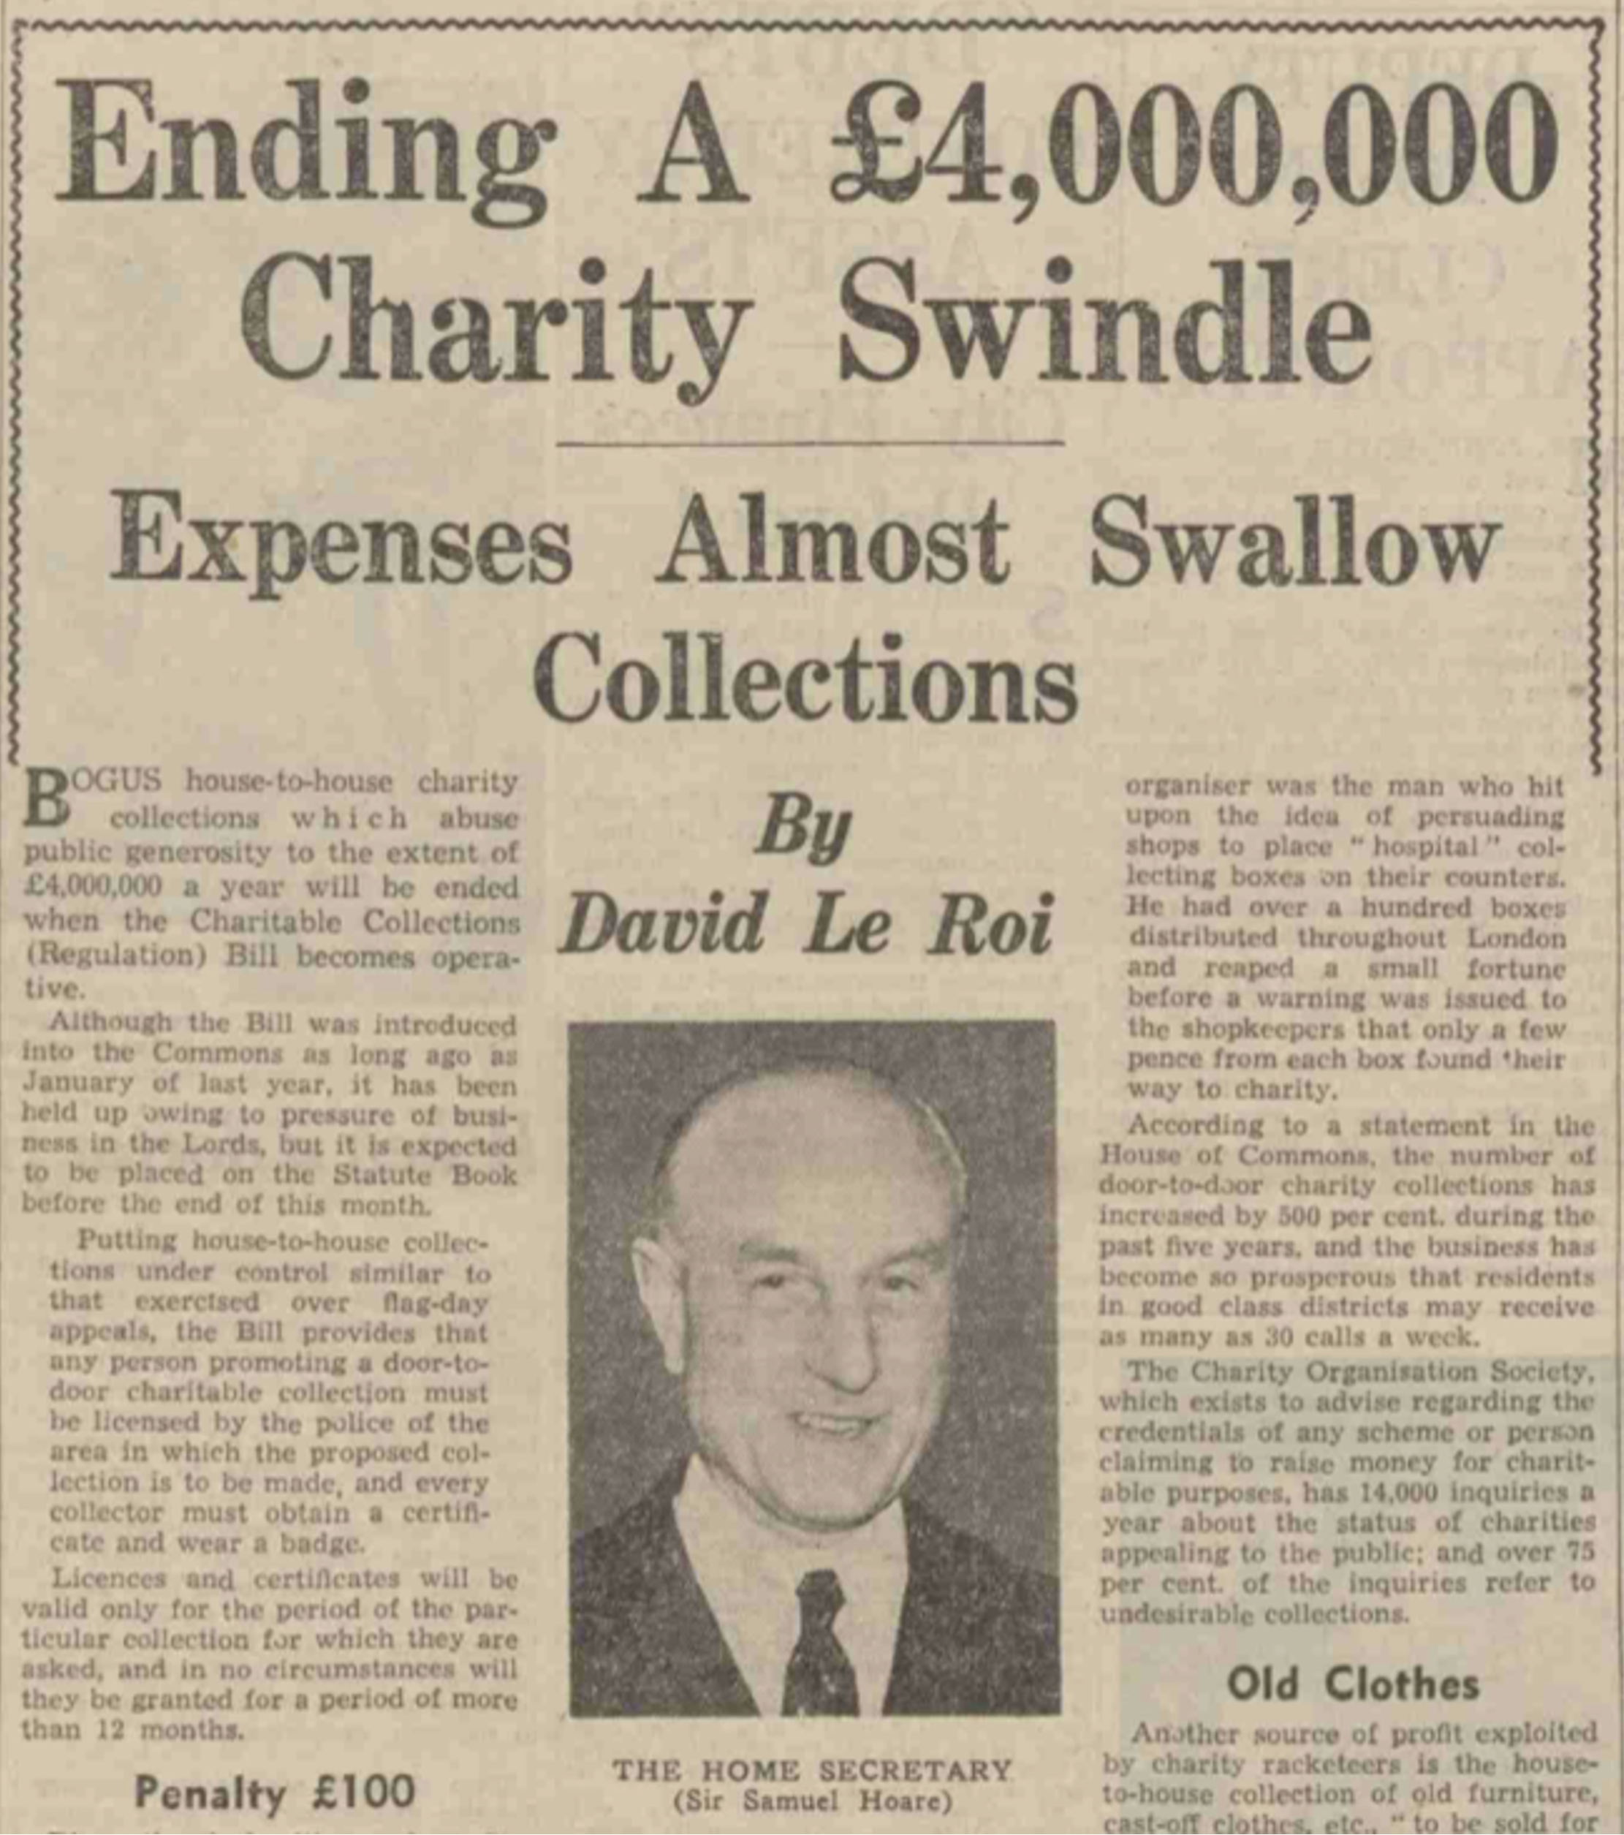
History repeating

Slide 4
Historiography
Historiography is the study of how history is studied and written.

Slide 5
Great men of fundraising
Mainly takes a ‘great man’ approach.
  Charles Sumner Ward
  Beth Breeze says such ‘great man accounts present an “origin myth” that fundraising as an organisational function dates only to the start of the 20th Century.

Slide 6
Social and cultural FR history
Social history
  Examines historical events in terms of social and economic factors and relationships that affected ordinary (rather than ‘great’ or ‘remarkable’) people, and explores how these related to changes in society.
Cultural history
  Considers “patterns of thought, understanding, modes of language, rituals of life and ways of thinking”.

Slide 7

Social and cultural FR history
What broader social conditions enabled the development of the systematic organisation of generosity?
  New ideas and thinking that emerged from the Enlightenment about how to improve society.
    An approach of cultural history )“patterns of thought, understanding, modes of language, rituals of life and ways of thinking”)

Slide 8
Social and cultural FR history
What broader social conditions enabled the development of the systematic organisation of generosity?
  The emergence of a public sphere that created spaces for collective social action, giving rise to many new charities, leading to the birth of “collective [and] associational philanthropy”

Slide 9
Social and cultural FR history
What broader social conditions enabled the development of the systematic organisation of generosity?
  The rapid spread of wealth across society, which enabled more people to participate in philanthropy, including the rise of the new ‘middling class’.

Slide 10
Research questions
The ‘social problem’ of fundraising
An ‘accidental’ profession
The role of women
Decolonisation of fundraising
Histories of fundraising methods
National fundraising histories

Slide 11
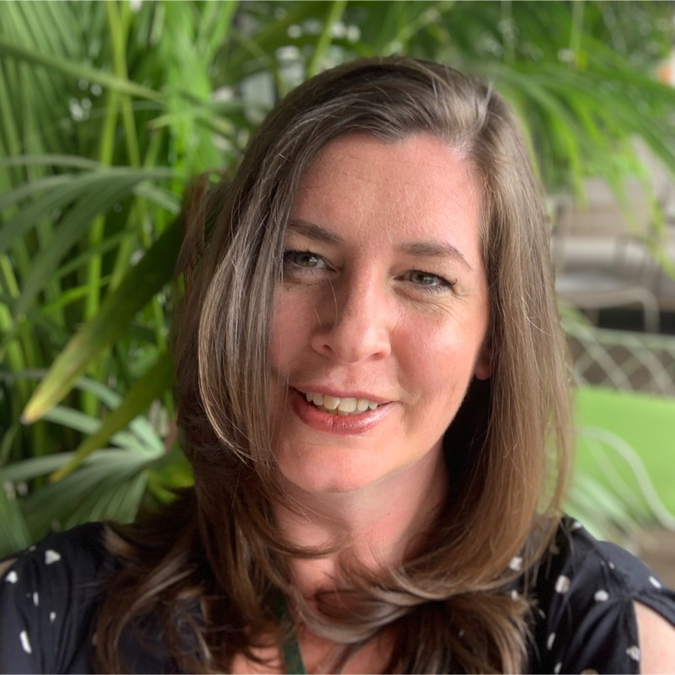
Project team
Marina Jones (UK) – project leader
Giovanna Bonora (Italy)
Emma Doran (Ireland)
Harpreet Kondel (UK)
Jayne Lacny (UK)
Sarah Lyons (Canada)
Mark Phillips (UK)
Daryl Upsall (Spain)

Slide 12
Fundraising history timeline
1788 – First civil case in Australia (Cable v Sinclair)
Supplies that had been purchased for a young couple and those child using funds received through a public fundraising campaign had gone missing.

Slide 13
Fundraising history timeline
1954 – First matching gift program is established by GE Foundation…
…through its Corporate Alumni Program, matching employee donations to schools and universities.

Slide 14
Fundraising history timeline
1819 – Door-to-door collecting by female-led auxiliary charities is well established. We know because…
…a letter is published saying that women who 'lightly trip from street to street, and from door to door, in the glorious office of collecting subscriptions from the poor and indigent' - shows a disdain and disapproval of fundraising and practices

Slide 15
Fundraising history timeline
Published summer 2022
Mechanism for fundraisers to submit new entries.

Slide 16
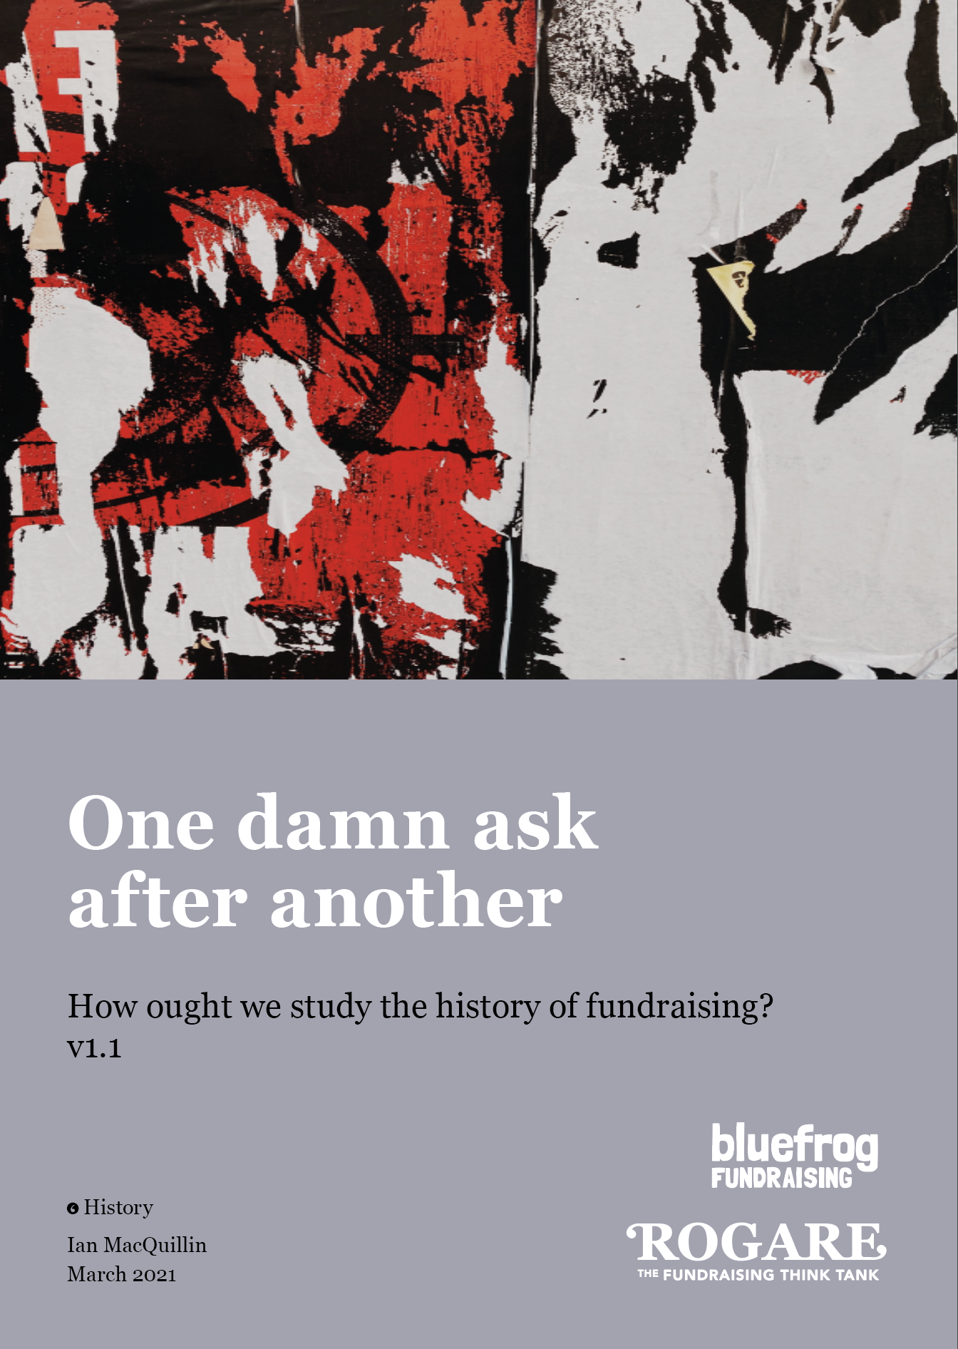
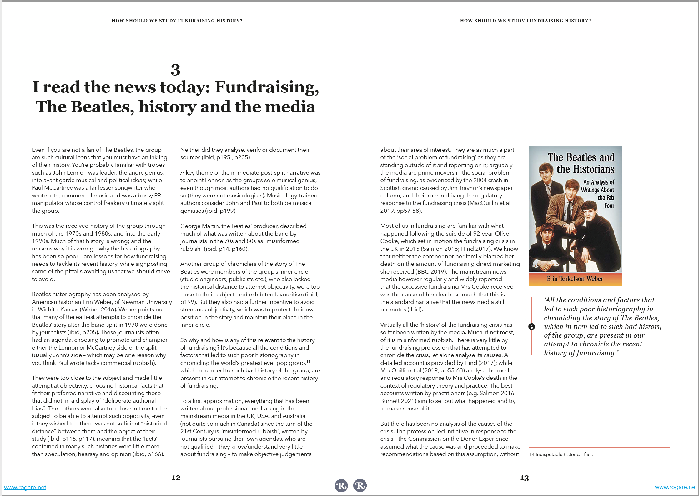
Rogare history project
https://www.rogare.net/history

Slide 17




Rogare Associate Members
Rogare is supported in our work by a number of Associate Members – partners to the fundraising sector that share our critical fundraising ethos. It is because of this support that we can make all our work freely available to the fundraising profession.

