Slide 1

Gender issues in fundraising
Heather Hill CFRE
Chappell & York
Chair of the Rogare Council

Slide 2
Phase 1 – A Recap
Phase 1 Goal: Understanding the Issues
Define key terms
Identify questions and issues
Pull together research, theory and practitioner perspectives for review and analysis
Initiate discussion

Slide 3
Phase 1 – Output
Terminology 101
Sexual harassment and violence
The career path of a female fundraiser
Lean In/Lean Out feminism and fundraising
Leadership and visibility
A roadmap for structural change

Slide 4
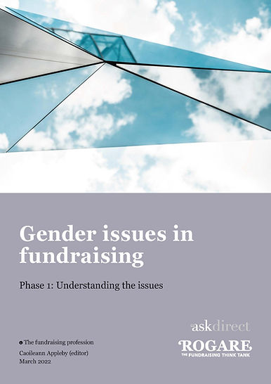
Phase 1 – For more reading:
https://www.rogare.net/fundraising-ethics-gender-issues
Project Leader:
Cailoeann Appleby
Project Team:
Ruby Bayley
Heather Hill
Ian MacQuillin
Ruth Smyth

Slide 5
Phase 2 – A Roadmap
Phase 2 Goal: Creation of a Roadmap
Identify the challenges
Identify potential solutions
Identify key audiences
Develop a roadmap for navigating the path to change
  A shift from ‘Lean In’ to ‘Lean Out’

Slide 6
Phase 2 – A Preview
Key challenges being covered:
Patriarchal structure
Sexism
Sexual harassment
Leadership (im)balance
Including men as agents of change

Slide 7
ETA: Summer 2022
Project Leader:
Heather R. Hill, CNM, CFRE
Project Team:
Ashley Belanger, CFRE
Elizabeth Dale, PhD
Jessica Rose, MSt
Becky Slack, MA

Slide 8




Rogare Associate Members
Rogare is supported in our work by a number of Associate Members – partners to the fundraising sector that share our critical fundraising ethos. It is because of this support that we can make all our work freely available to the fundraising profession.

