Slide 1

Rethinking fundraising ethics
Ian MacQuillin
Director
Rogare – The Fundraising Think Tank

Slide 2
Applied vs normative ethics
Applied ethics tells you WHAT you ought (or ought not) do.
Normative ethics helps you understand WHY you ought (or ought not) do it.

Slide 3
Fundraising ethics
Mostly applied ethics in codes of practice
  Often set by regulatory bodies rather than professional bodies
  Ethics often conflated with code compliance.
Little theory or theory development at level of normative ethics.

Slide 4
Code of Fundraising Practice
Fundraisers MUST:
Obtain permission for using case studies (where practical) (s3.4.2)
Generally avoid mass mailing or cold calling trusts (s13.2.1)
Wear an ID badge if they are doing street fundraising (s8.4.12)
Undertake due diligence on both the financial and reputational dealings of potential partners before donations are accepted (s2.3.3)
Implement procedures to avoid congestion at events (s11.7.2)
Avoid soliciting people under 18 (s1.3.11)

Slide 5
Code of Fundraising Practice
Fundraisers MUST NOT:
Take advantage of mistakes made by the donor (s1.3.3)
Exaggerate facts about beneficiaries (s1.3.1)
Try to get someone to switch a donation from another charity (s1.1.4)
Include a gift in DM that’s aimed at generating a donation based on ‘financial guilt’ (s9.3.3)
Call on houses displaying a No Cold Callers sticker (s8.4.3)
Ask for a financial contribution more than three times during a telephone call (s9.4.17)

Slide 6
Code of fundraising practice
Organisations MUST NOT engage in fundraising which (s1.2.1):
  Is an unreasonable intrusion on a person’s privacy
  Is unreasonably persistent
  Places undue pressure on a person to donate.

Slide 7
Grey areas and dilemmas
How much intrusion into privacy is ‘unreasonable’?
  Does this mean that some intrusion is reasonable? If so, in what contexts?
How much persistence is ‘unreasonable’?
  Does this mean that some persistence is reasonable? If so, in what contexts?
How much and in what contexts is pressure ‘undue’?
  Does this mean some pressure is ‘due’ (i.e. permissible). In what contexts?

Slide 8
Normative fundraising ethics
Protection of public trust – ‘Trustism’
Servicing the donor’s needs, wants and aspirations – Donorcentrism
Servicing philanthropy.

Slide 9
Trustism
Fundraising is ethical when it maintains and protects public trust.
  And unethical when it does not.

Slide 10
Donorcentrism
Fundraising is ethical when it gives priority to the donor’s wants, needs, desires and wishes (and this maximises sustainable income for the nonprofit)
  And unethical when it does not.

Slide 11
Service of philanthropy
Fundraising is ethical when it delivers meaning to a donor’s philanthropy
  And unethical when it does not.

Slide 12
Normative fundraising ethics
The principal agent in much – even most – fundraising ethics (and fundraising regulation that incorporates these ethics) is…
The donor.
Beneficiaries are rarely considered stakeholders in fundraising’s ethical dilemmas or ethical decision making.

Slide 13
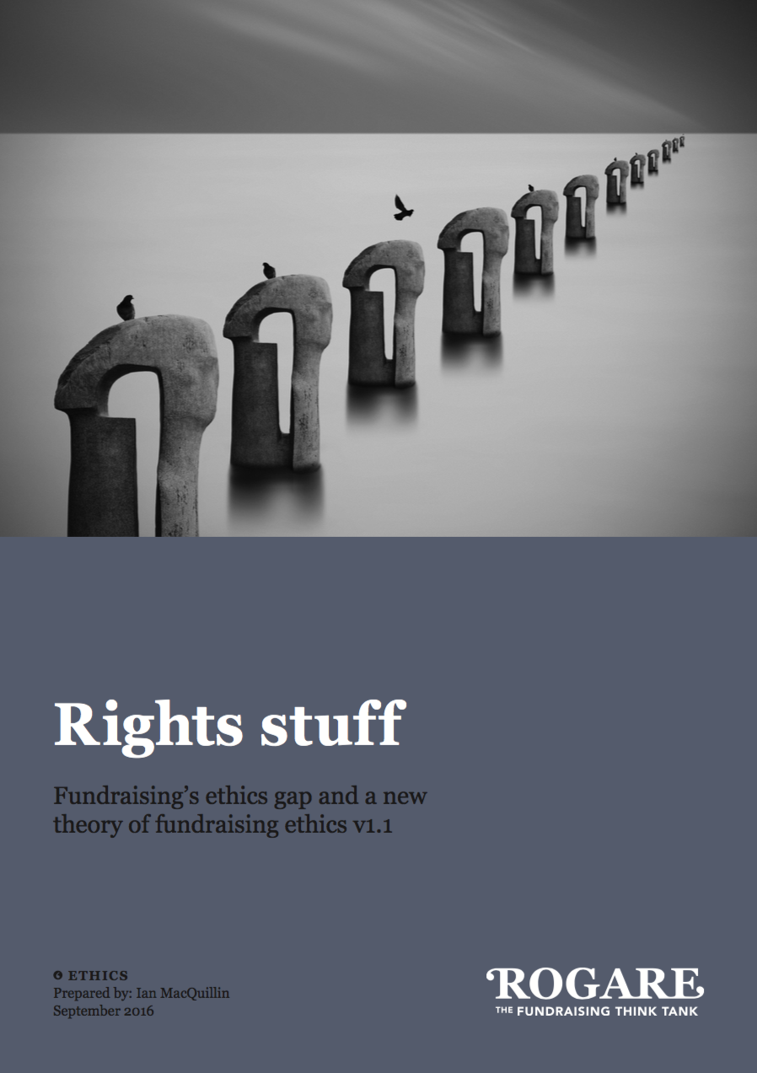
Rights-Balancing FR Ethics
Putting beneficiaries into ethical decision making in fundraising.
https://www.rogare.net/normative-fundraising-ethics

Slide 14
Rights-Balancing FR Ethics
Fundraising is ethical when it balances the duty of fundraisers to ask for support (on behalf of their beneficiaries) with the relevant rights of the donor…
…such that a mutually optimal outcome is obtained and neither stakeholder is significantly harmed
  And unethical when it does not get this balance right.

Slide 15
Consent or legitimate interest?
Some charities opted to only contact donors if they have their consent to do so.
  (If you ask for consent and it is not given, then you can no longer use the legal basis of legitimate interest.)

Slide 16
Consent or legitimate interest?
Should you always gain donors’ consent (in cases where this is not legally required) as a matter of policy?
Trustism – PROBABLY
Donorcentrism – POSSIBLY
Service of philanthropy – PROBABLY
Rights balancing – NO
(or rather NOT NECESSARILY)

Slide 17
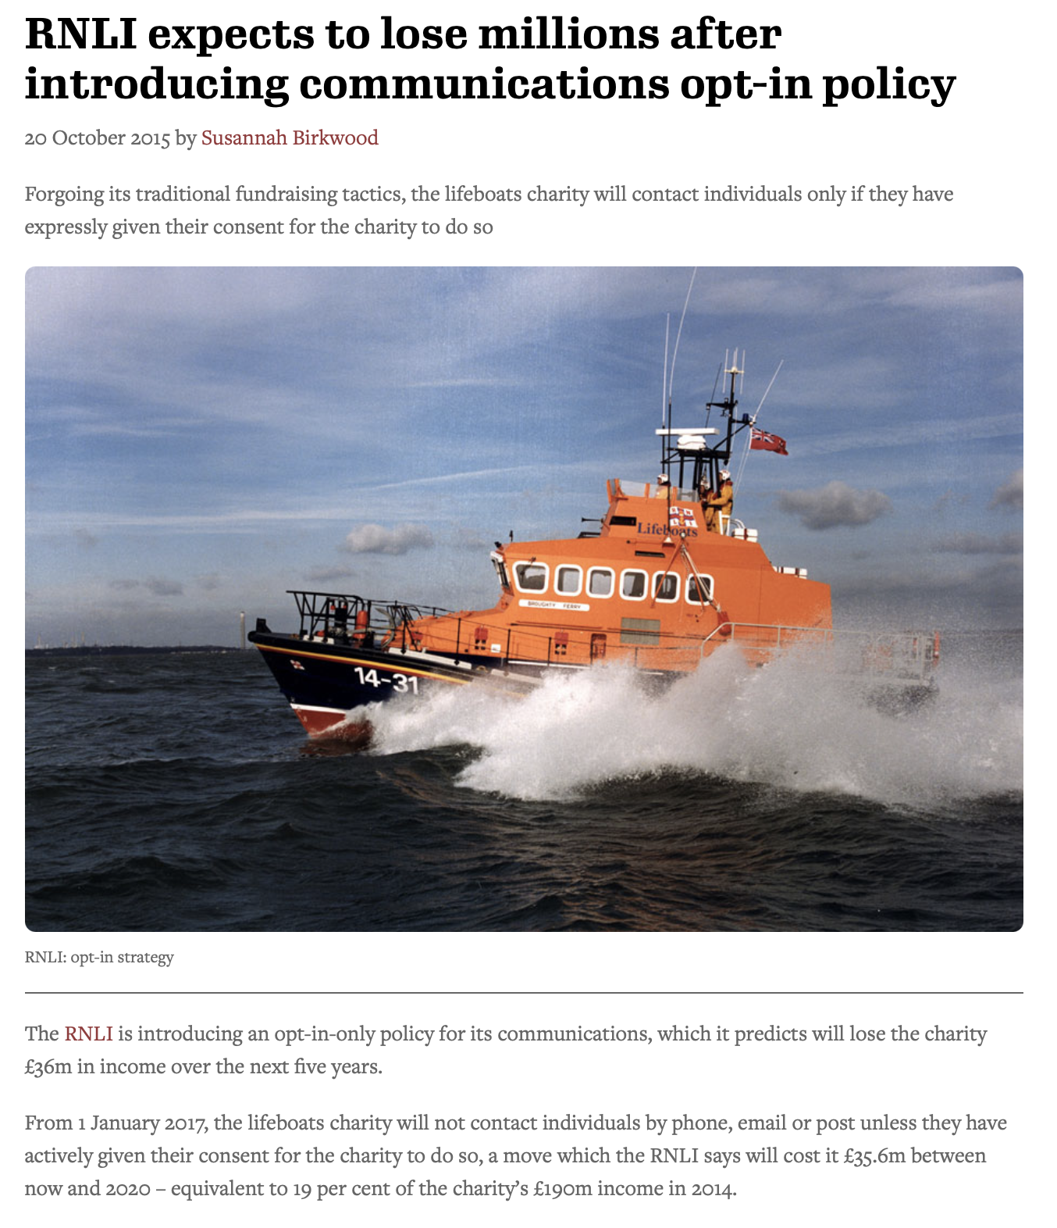
And this is why…

Slide 18
Rights-Balancing in practice
Scottish Fundraising Guarantee Statement
Fundraising is the life blood of many Scottish charities and we need to raise funds from voluntary sources. We could not fulfil our charitable mission without the support of generous, thoughtful and committed donors. We value the support of donors and understand the need to balance our duties to beneficiaries, with our duties to donors.

Slide 19
Rights-Balancing in practice
Fundraising Institute of Australia guidance on emergency appeals
Forms bedrock of ethics syllabus for Chartered Institute of Fundraising Academy courses.

Slide 20
Further ethical issues
Donor dominance and power imbalances in donor-fundraiser relationships
Beneficiary/service user framing
  Jess Crombie is talking about this later
Community-centric fundraising (CCF)
  And the tension with donor-centred fundraising
Virtue ethics and care ethics in fundraising

Slide 21
Donor dominance
An imbalance of power wherein the donor exhibits controlling behaviour that compromises the mission of an organisation and/or its ability to serve its beneficiaries

Slide 22
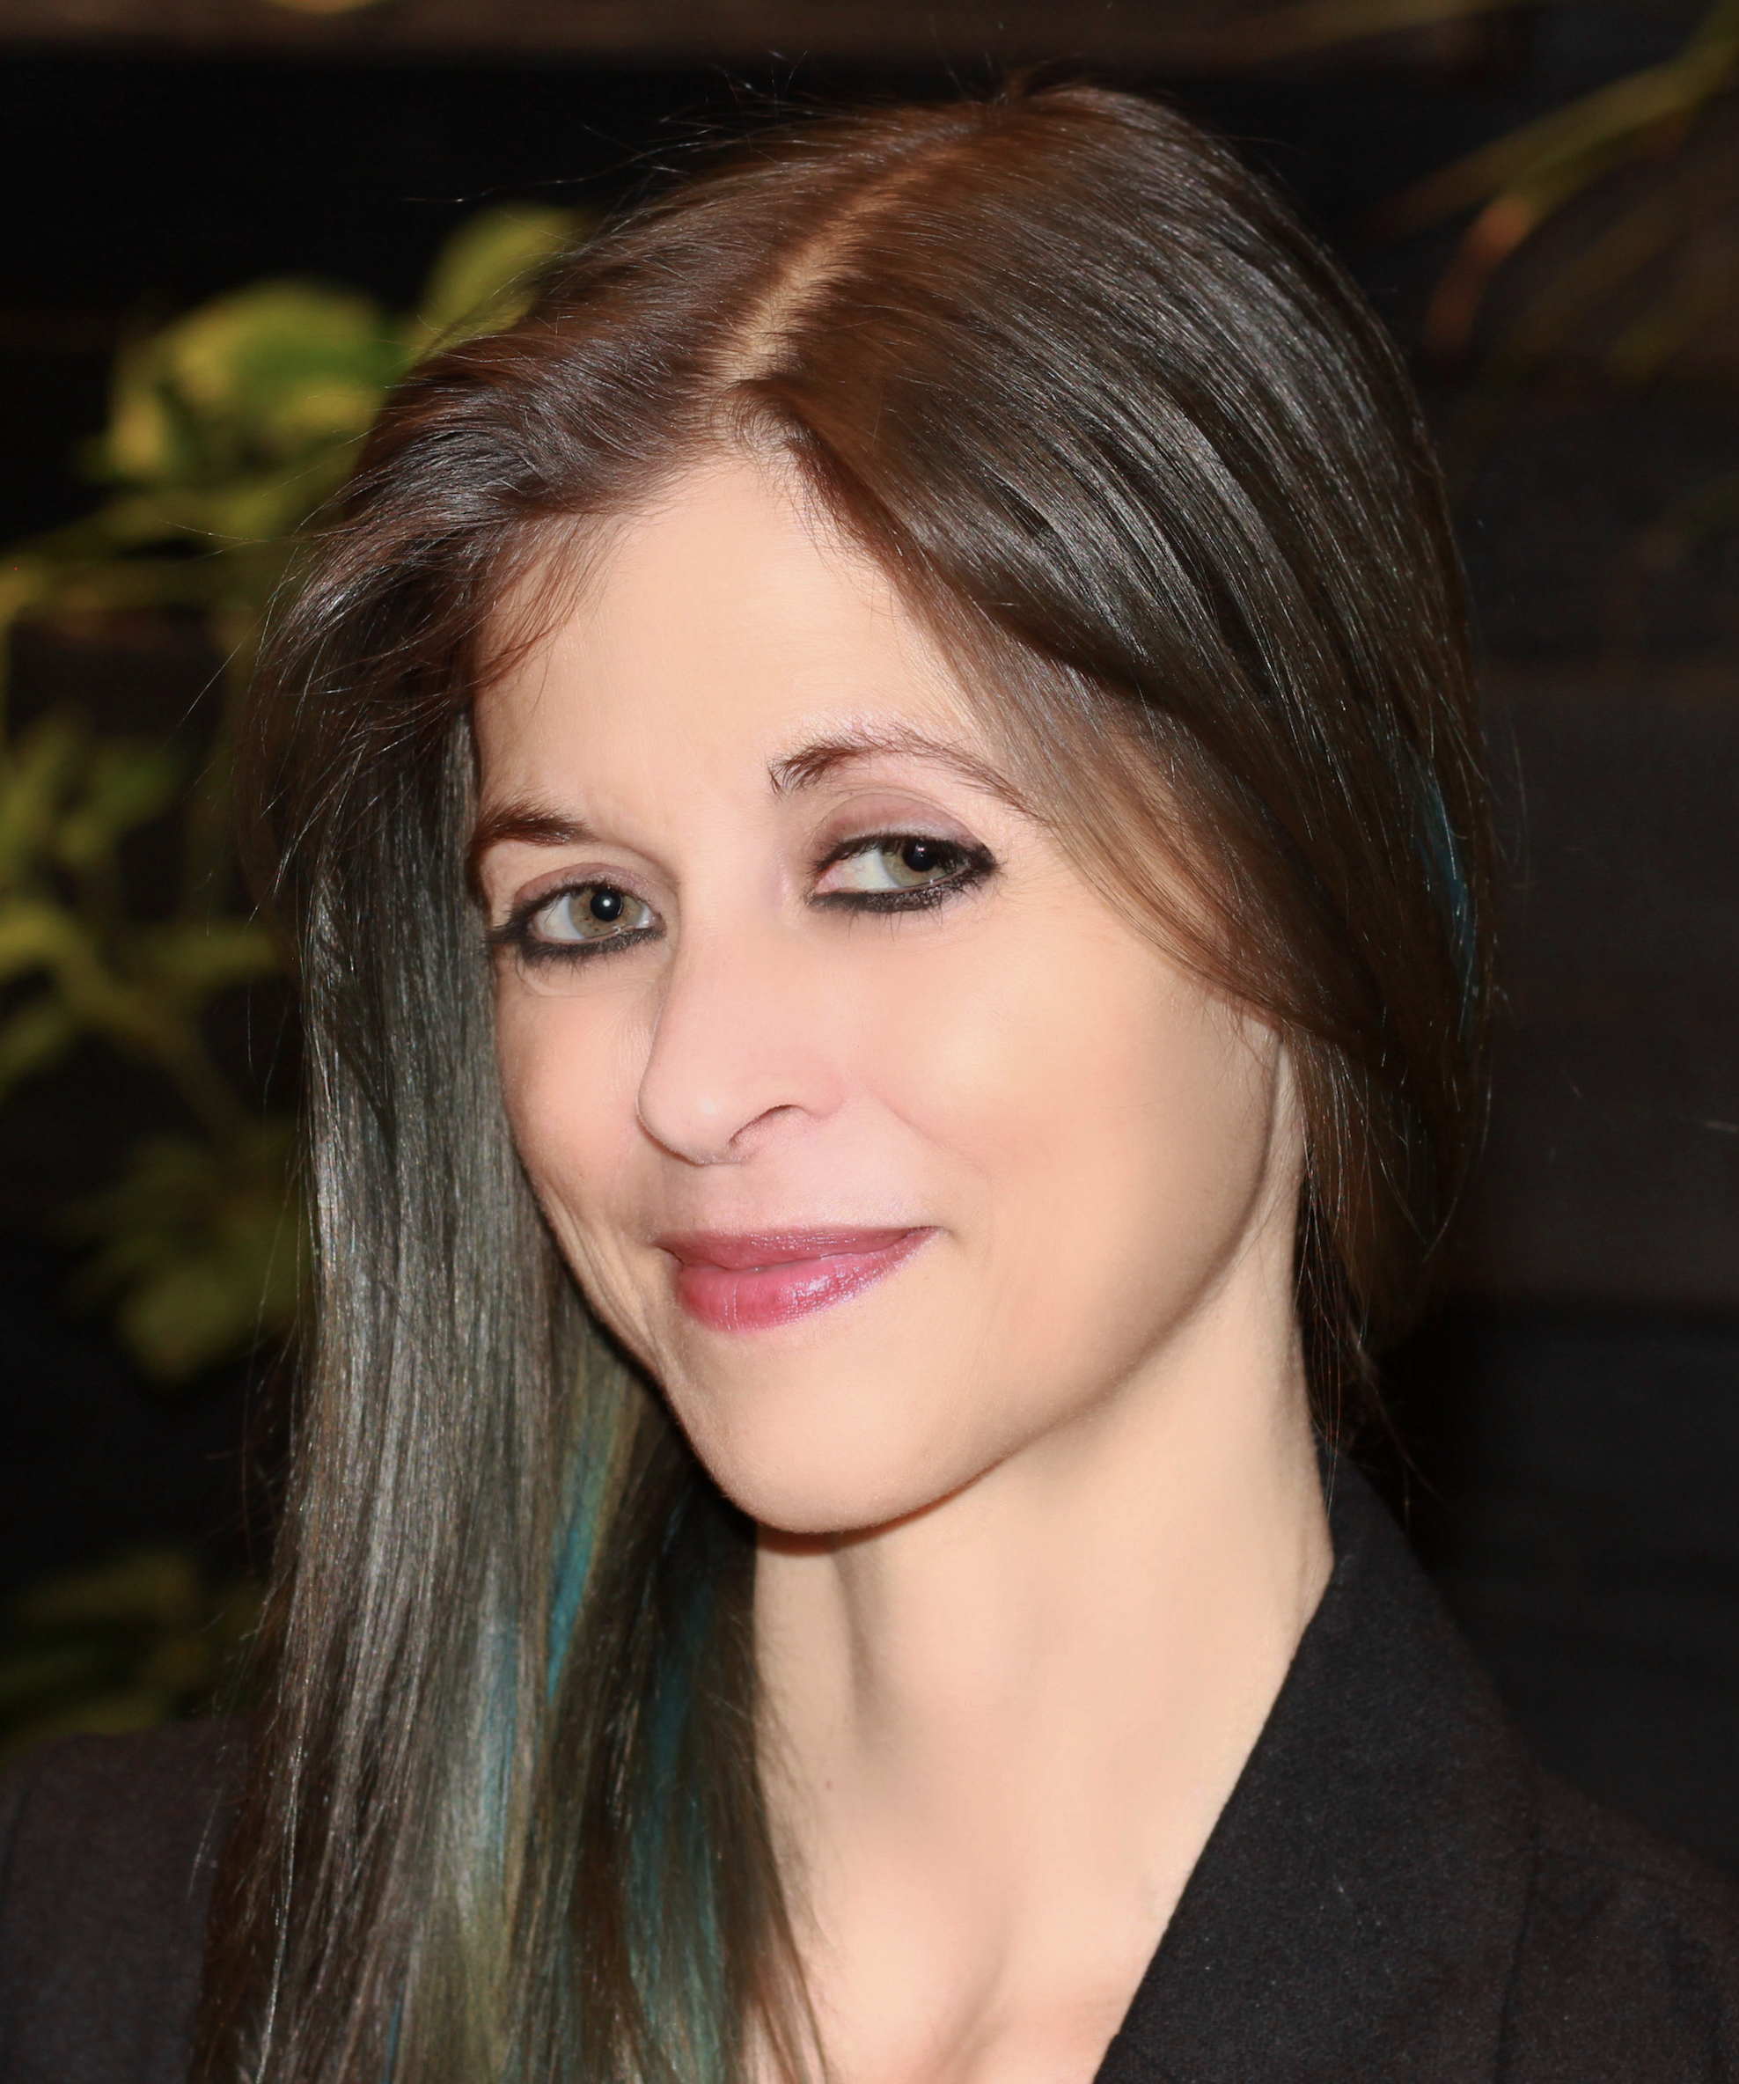
Donor dominance
Rogare’s work on donor dominance
  Led by Heather Hill
https://www.rogare.net/donor-dominance

Slide 23
Donor dominance
Type 1 – Dominance in Direction
Governance
Policy
Administration
  Operations
  Personnel
  Programs

Slide 24
Donor dominance
Type 2 – Dominance in relationships
Leadership (Board, administration)
Fundraising staff
Program staff
Peers/other donors

Slide 25
Donor dominance
Type 3 – Dominance in behaviour
Expectations of treatment
Regard (or disregard) for beneficiaries
Public influence

Slide 26
Donor demands
In attempting to update to a more progressive lens of history, a donor said that we would lose their support if we at all were explicitly non-negative (neutral to positive) on LGBTQ+ identities and race. The staff did so for years up until the point I left.

Slide 27
Donor demands
Several donors stated that they would stop donating if our organisation would go on doing business with a certain bank they didn't like.

Slide 28
Donor demands
A demanding volunteer board member used charity resources for his own events. These were badged as supporting the charity but did not result in any income. He implied that I should do what he wanted if we were to continue to count on his support.

Slide 29

Community-centric fundraising
https://communitycentricfundraising.org

Slide 30
Community-centric Fundraising
Fundraising and philanthropy are currently unjust on economic and racial grounds.

Slide 31
CCF critique of DCF
Perpetuates white saviourism
Marginalises, ‘others’ and crowds out the voices of the communities charities claim to serve
Gets in the way of having honest conversations with donors and building “true” partnerships, and in so doing “short-changes” donors out of having the best and most authentic relationships they could have with charities
Fuels systematic injustice.

Slide 32
CCF critique of DCF
Fundraisers ought to have “difficult conversations” with donors about their giving, and how this sits in the context of their power and privilege.

Slide 33
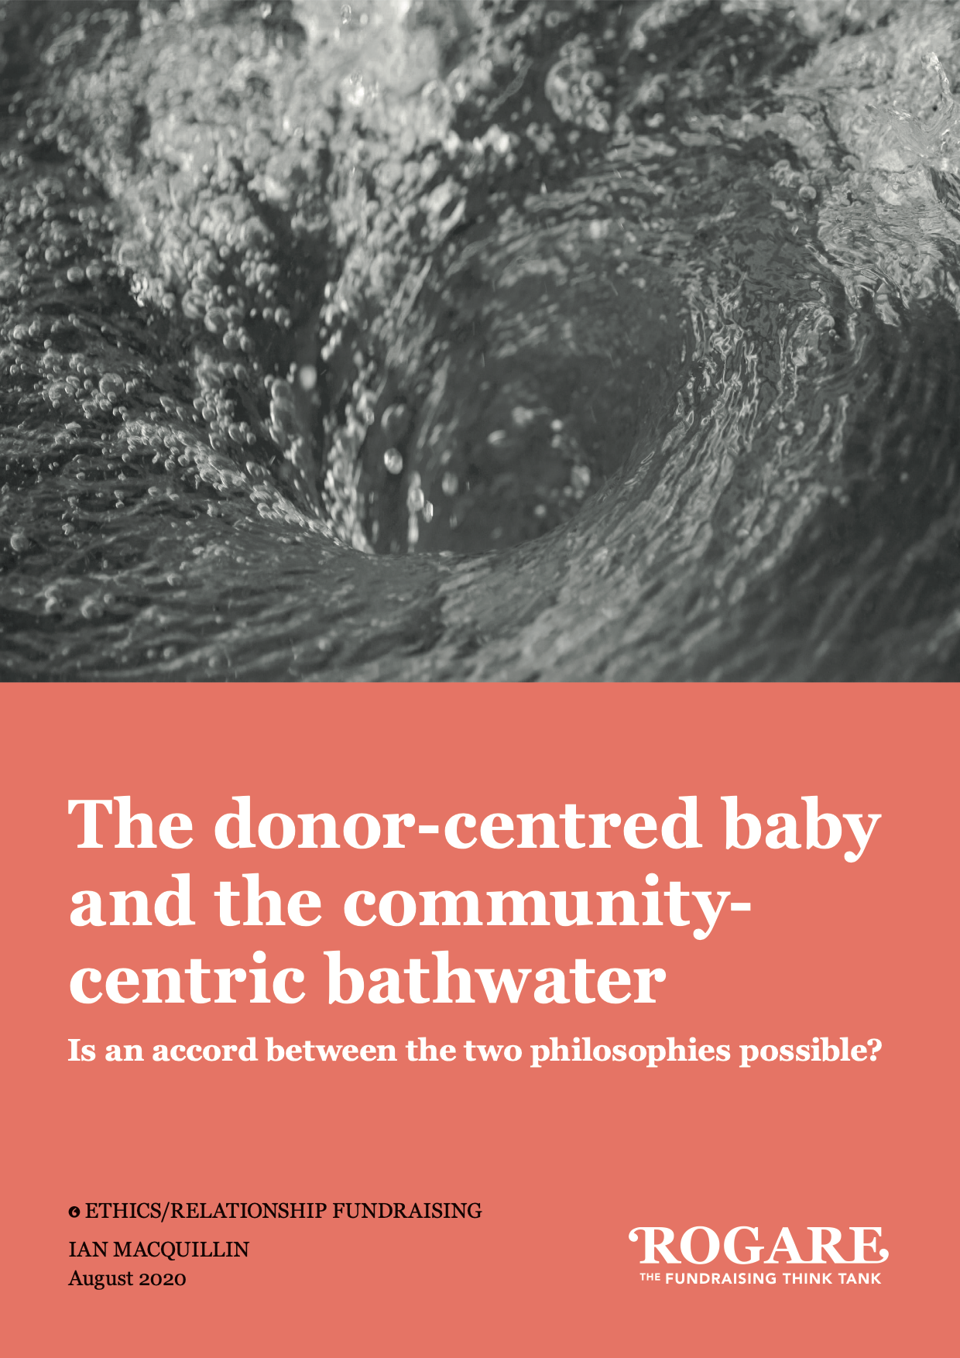
CCF critique of DCF
How can/should/will donor-centred fundraising practice and ethics respond to these critiques?
https://www.rogare.net/community-centric-fr

Slide 34
Expanding fundraising ethics
Journal of Philanthropy and Marketing special issue on normative fundraising ethics.

Slide 35
Expanding fundraising ethics
Review of the field 1990-2021
  Ian MacQuillin
  https://onlinelibrary.wiley.com/doi/full/10.1002/nvsm.1740 (open access)
Applying stakeholder theory to FR ethics
  Dr Ruth Hansen, University of Wisconsin
The role of fundraisers in building equitable communities
  Dr Brittany Keegan, Virginia Commonwealth University

Slide 36
Expanding fundraising ethics
Ethics of service user framing
  Ian MacQuillin, Jess Crombie (London College of Communication) & Ruth Smyth (BoldLight/Rogare)
  https://onlinelibrary.wiley.com/doi/10.1002/nvsm.1752 (open access – thank you Kingston U)
Ethics of fundraising to and from children
  DrAlison Body, Dr Emily Lau, Dr Lindsey Camneron (Kent U) & Dr Shazza Ali (Bristol U).

Slide 37
Expanding fundraising ethics
Tackling moral dilemmas in fundraising
  Dr Jess Burgess, Brighton and Sussex University Trust/Rogare.
Applying normative theories to practice
  Dr Claire Routley (Kent U/Rogare) & Cherian Koshy CFRE (Endowment Partners LLC/Rogare).

Slide 38
Expanding fundraising ethics
Two articles on care ethics and fundraising (not yet published)
  Dr Stephanie Madden (Penn State U), Dr Virgina Harrison (Clemson U), Michail Vafeiadis (Auburn U).
  Sarah Willey CFRE & Cristopher Owens (University of Missouri – St Louis).

Slide 39
(Feminist) care ethics
Grew out of feminist ethics (Carol Gilligan and Nel Noddings) in early 80s as a reaction to what were perceived as ‘masculine’ concepts of justice and rights.
Noddings calls care a ‘feminine ethic’.

Slide 40
Care ethics
Maintain relationships by contextualising and promoting the well-being of care givers and care-receivers in a network of social relations.
Meeting needs of others and ourselves
‘Care’ is a virtue
  Marueen Sander-Staudt 2012

Slide 41
Care ethics
Care ethics moves the locus of ethicality away from the individual, and the moral rules that protect them (such as negative non-interference rights), to meeting the needs of those for whom we take responsibility, which takes highest priority.
  Virginia Held, The Ethics of Care: Personal, Political, and Global

Slide 42
Care ethics
Care ethics thus provides the possibility of a total reconceptualistion of fundraising ethics
  Particular the ethics and practice of ‘relationship’ fundraising.

Slide 43
The virtuous caring fundraiser
Caring
  Ensures care can be provided for those who need it.
Judicial
  Can exercise independent judgement (or ‘professional autonomy’) in balancing their duties to their donors and her beneficiaries.
Competent (professional)
  Possesses sufficient professional knowledge and skill to successfully discharge their role.
Empathetic
  The ability to understand both the needs of donors and beneficiaries.

Slide 44
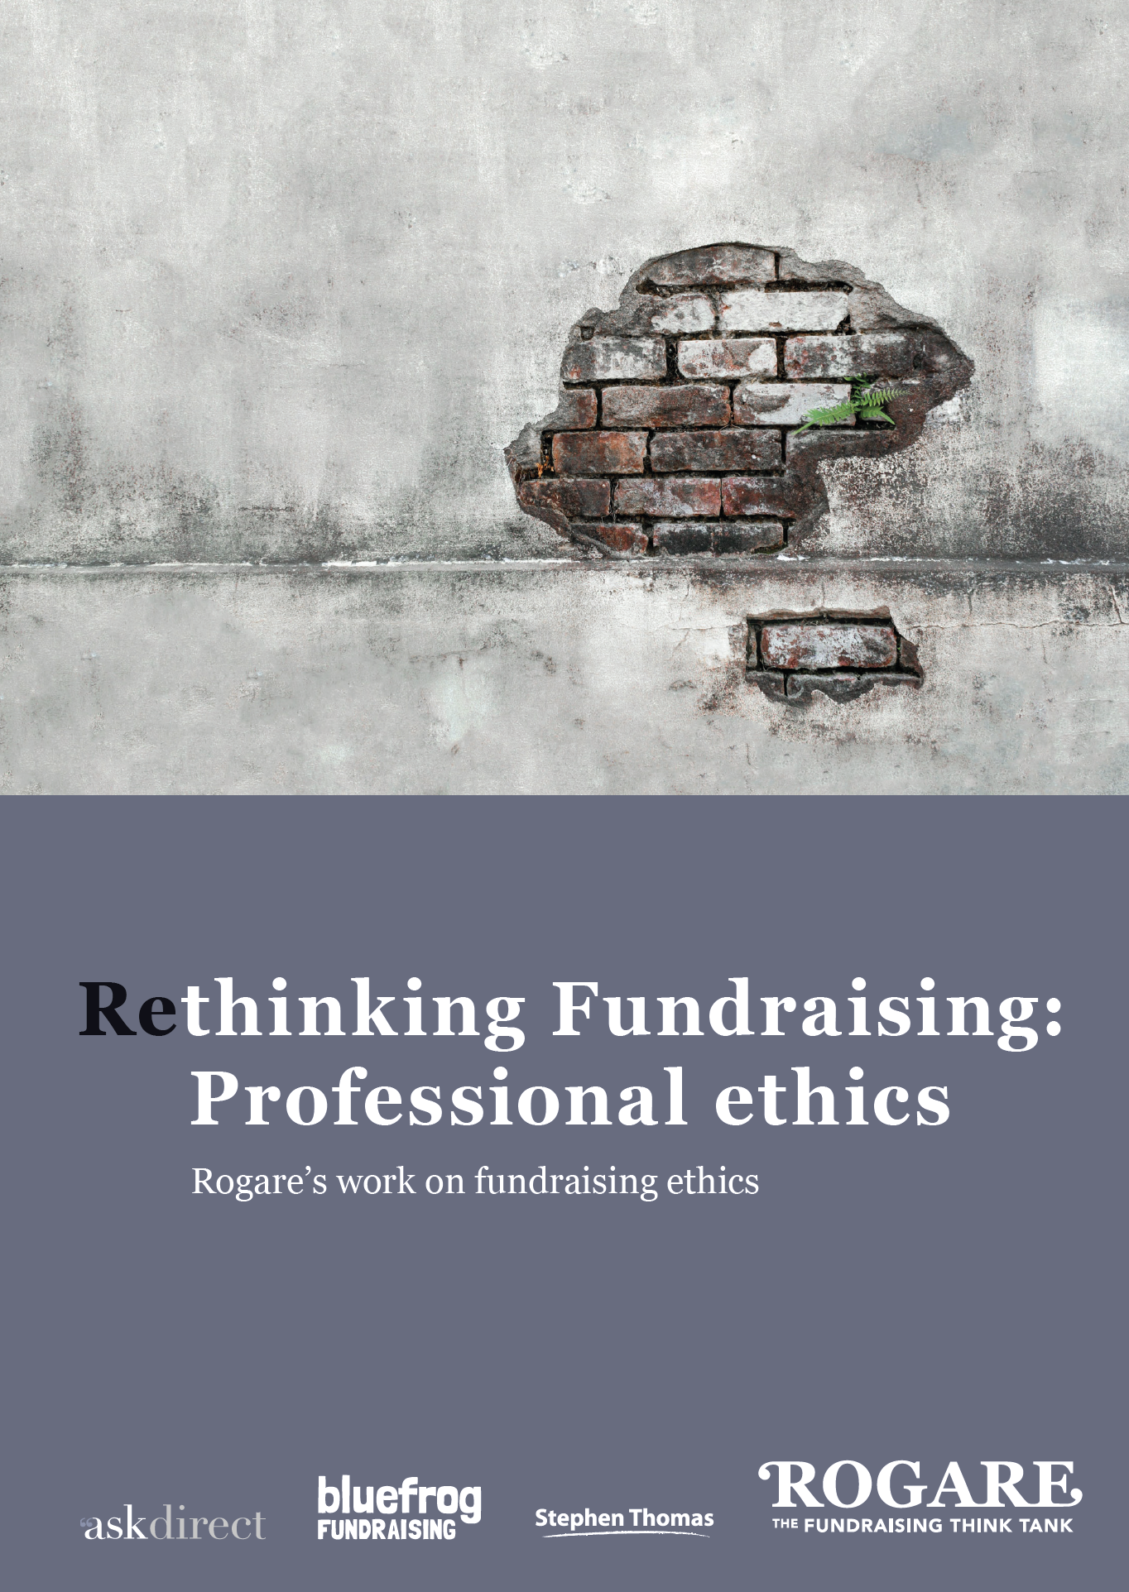
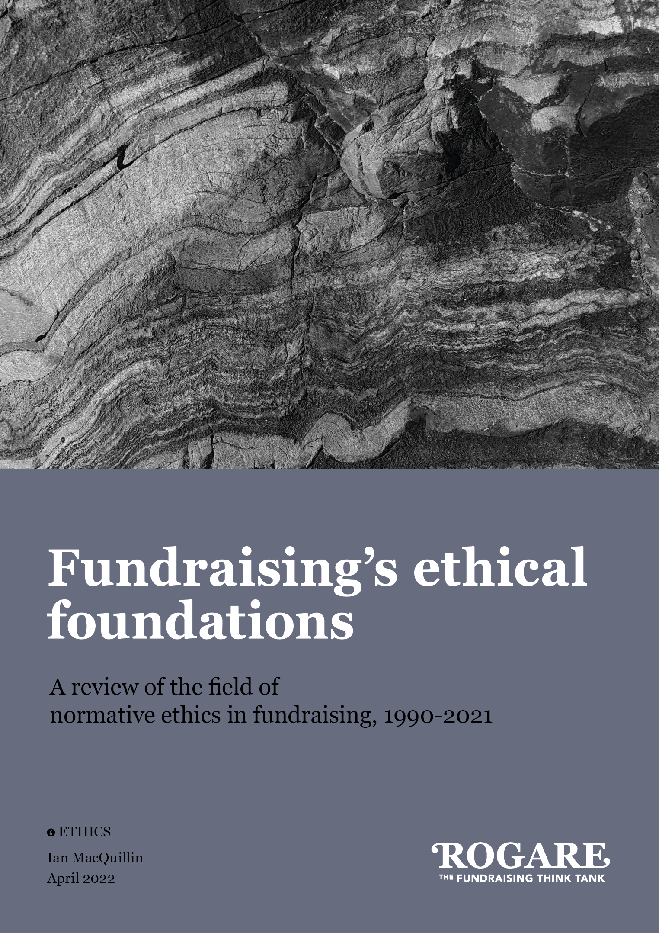
Expanding fundraising ethics

Slide 45




Rogare Associate Members
Rogare is supported in our work by a number of Associate Members – partners to the fundraising sector that share our critical fundraising ethos. It is because of this support that we can make all our work freely available to the fundraising profession.

