Slide 2
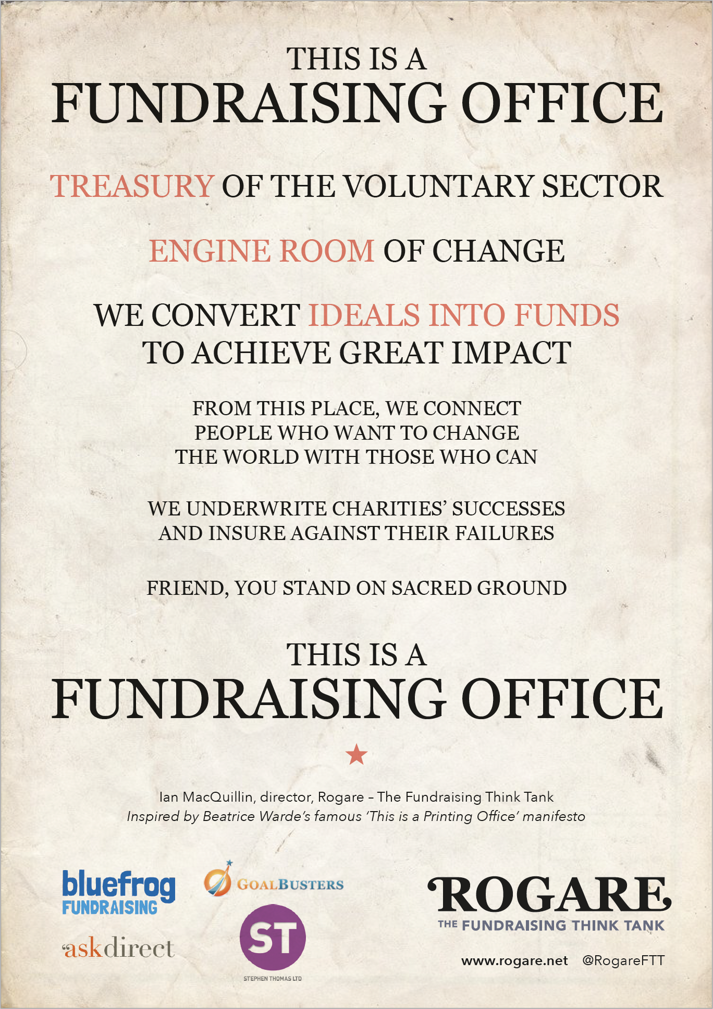

Slide 3

Rethinking Fundraising
Ian MacQuillin

Slide 4




Ian MacQuillin
Director, Rogare – The Fundraising Think Tank
ianmacquillin@rogare.net
www.rogare.net
@RogareFTT
Facebook: Critical Fundraising Forum

Slide 5
About me
Former:
Head of communications at Public Fundraising Regulatory Association
  2009-2013
Turner PR
  2006-2009
Journalist (editor of Professional Fundraising)
  2001-2006
Journalist (various)
  1988-2001

Slide 6
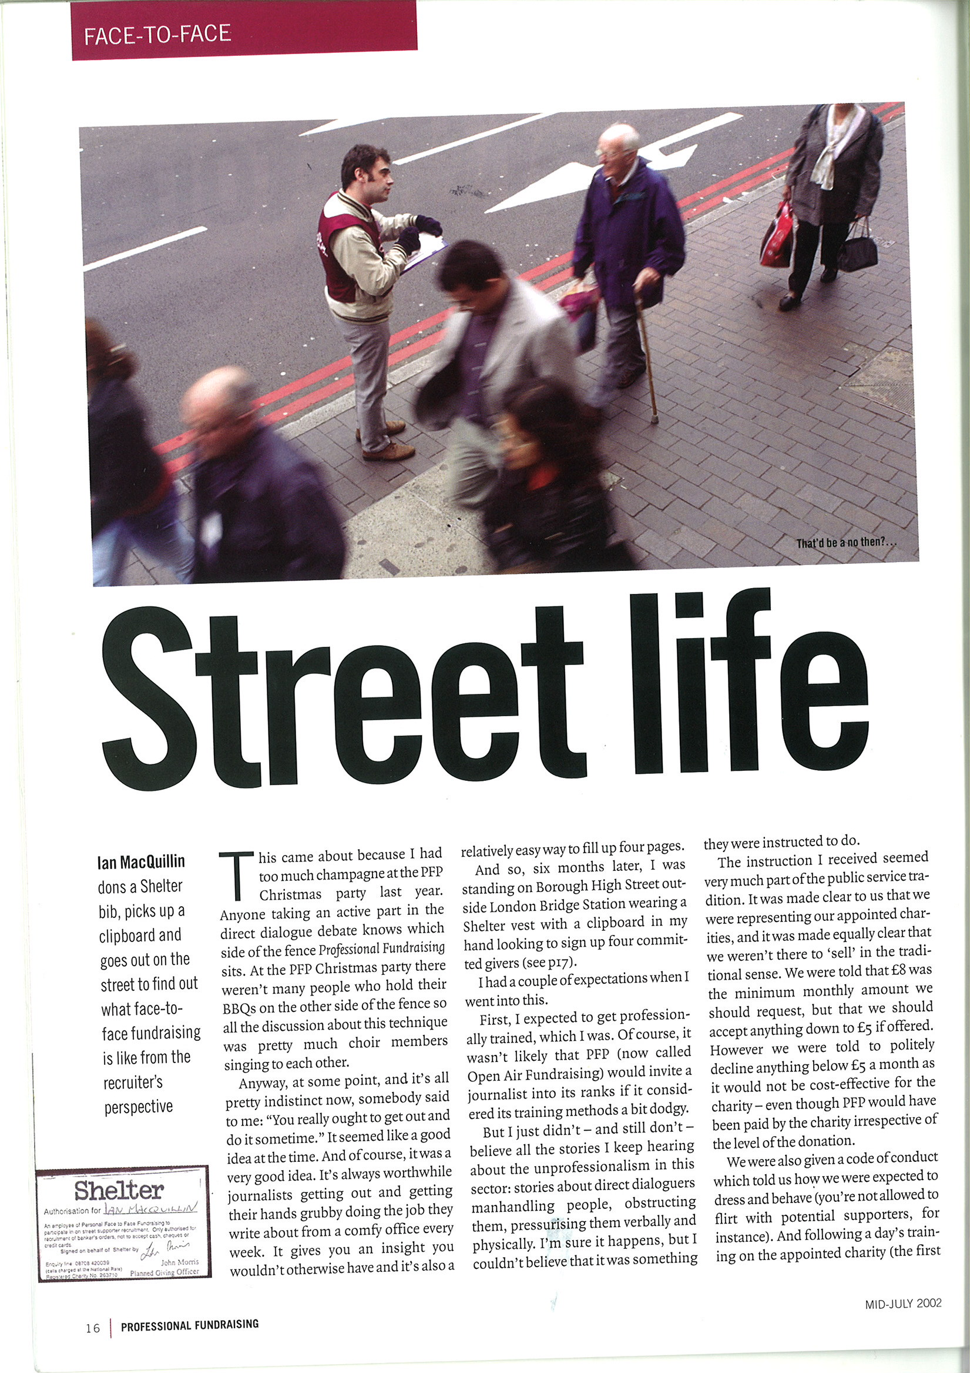
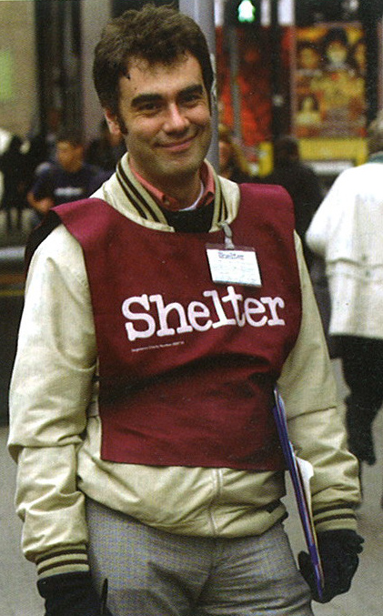
About me

Slide 7
What is Rogare?
Fundraising think tank
Latin for ‘to ask’
University of Plymouth 2014-19
Community Interest Company 2019 to date

Slide 8
What is Rogare?
The bridge that links the academic and practitioner branches of the fundraising
profession and the engine that turns academic theory and research into actionable ideas for fundraisers.

Slide 9
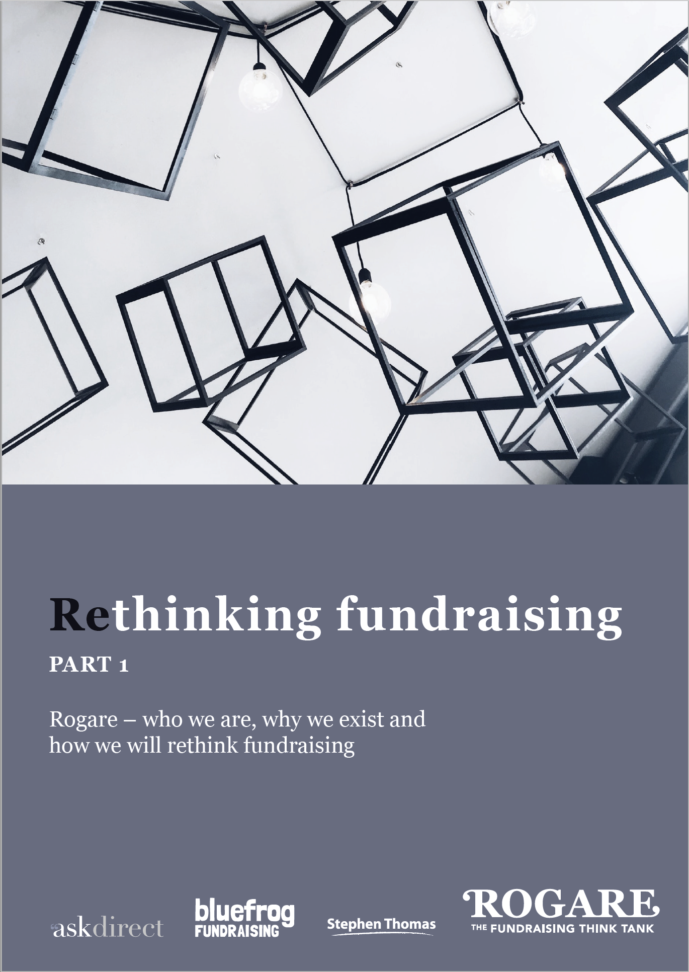
Rethinking fundraising
https://www.rogare.net/rethinking-fundraising

Slide 10
The problem
The practice of fundraising is not built upon a sufficiently rich and robust knowledge base, and the fundraising profession does not always sufficiently value, seek out, and use the knowledge that is available to it.

Slide 11
How do we know this?
How often do fundraisers consult academic research before making decisions?
  48 per cent – Never
  45 per cent – Sometimes
  07 per cent – Regularly
    Science and Philanthropy Initiative (Chicago University)
    https://www.rogare.net/critical-fundraising

Slide 12

How do we know this?
Many participants ‘‘readily admitted
they had no standard practice, did not adhere to accepted techniques, and had never read any book about fundraising or been on a training courseʼʼ.
  Breeze 2017, p91.

Slide 13
How do we know this?
‘Copy the case study’ model of conference presentations.

Slide 14
The solution
We need to RETHINK both the type of knowledge that underpins fundraising, and bring about a culture change in how fundraisers learn, acquire and value that knowledge.

Slide 15
What must we rethink?
Rethink what knowledge fundraisers need.
Rethink from where we get our knowledge.
Rethink how we evaluate that knowledge and how we use and apply it.
Rethink how we value that knowledge.
Rethink all the things we think we know for certain.
Rethink and challenge the status quo in fundraising and not be indoctrinated by it.

Slide 16
Rogare’s twin objectives
1. Develop a richer knowledge base
2. Change the culture of learning in fundraising.

Slide 17
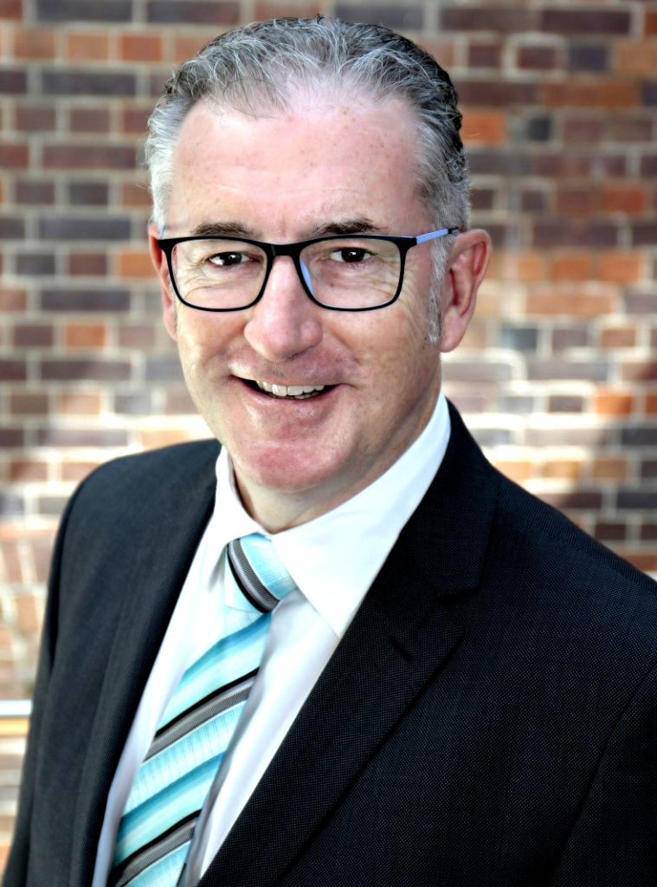
Critical fundraising
Are we intellectually curious enough about fundraising?
Nigel Harris
Rogare Council member/Giving Architects Australia
https://criticalfundraising.com/2019/08/28/opinion-are-we-curious-enough-about-fundraising/
Rogare’s aim is to foster that intellectual curiosity and to get fundraisers to ask the right question about their profession and its knowledge (and gaps therein).

Slide 18
Critical Fundraising
Critical Fundraising is a concerted attempt to critically and constructively evaluate issues and provide practical solutions to them.

Slide 19
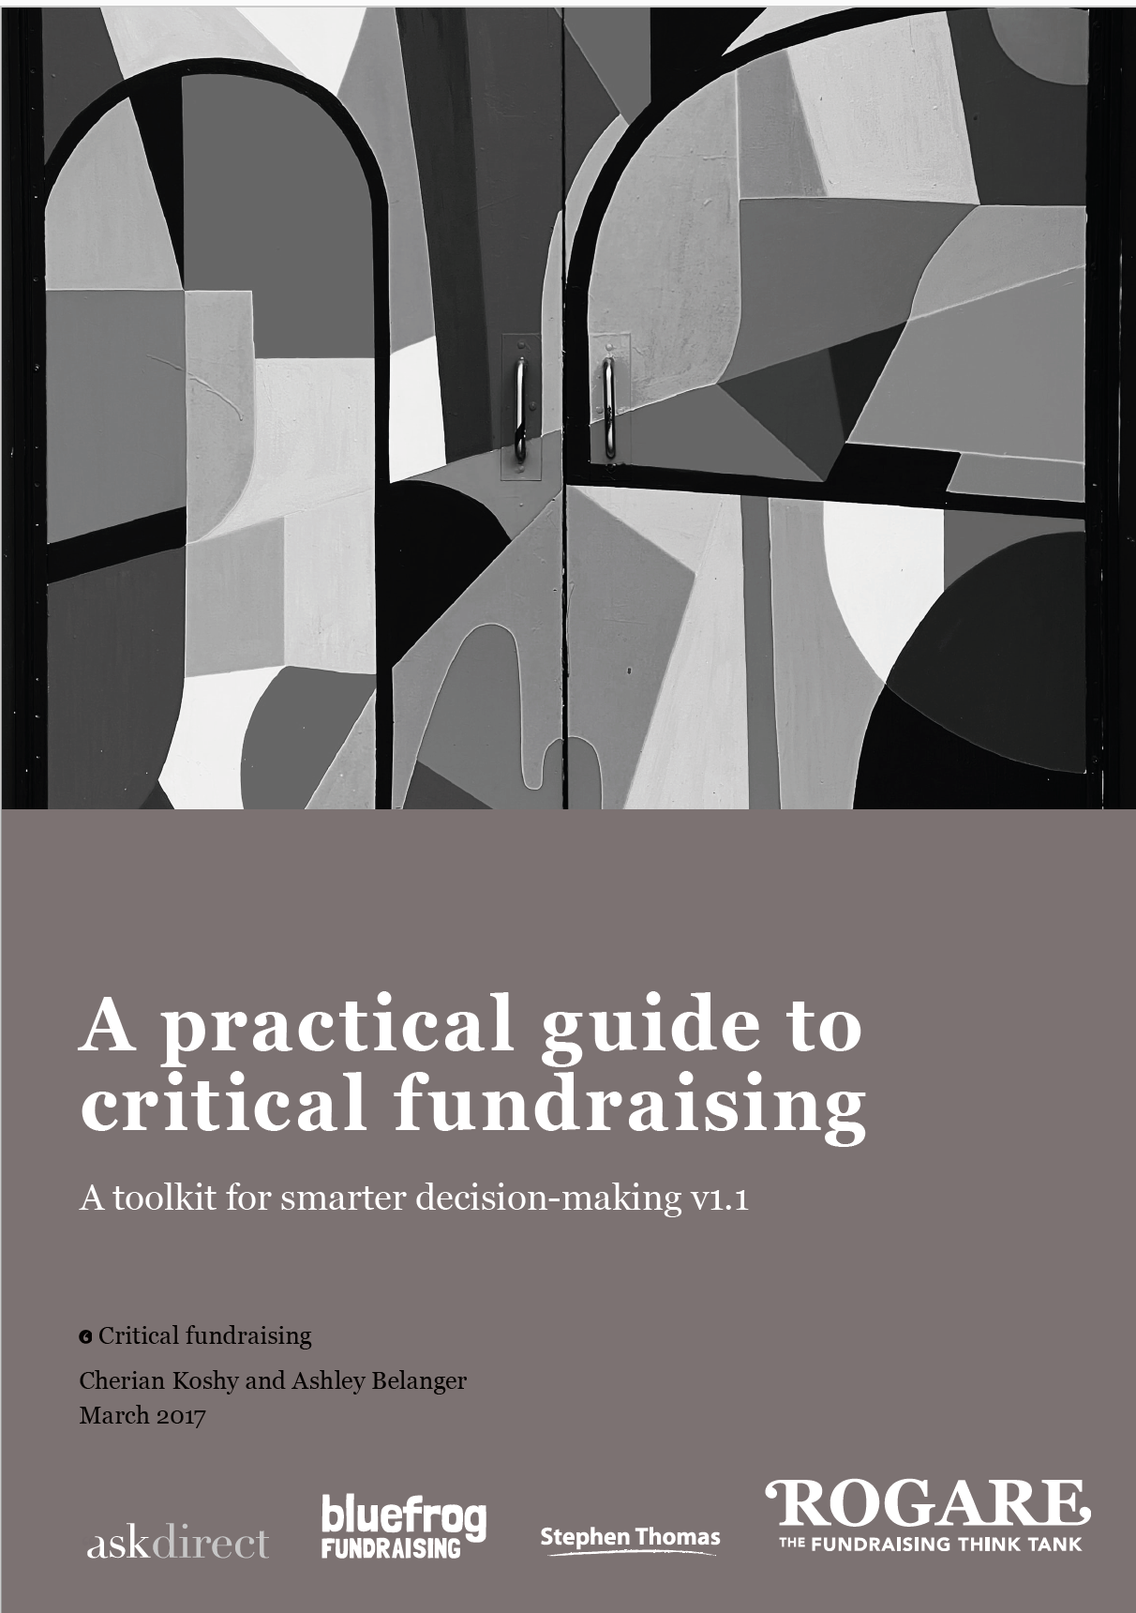
Critical Fundraising
Term borrowed from Critical Marketing (but not derived from it).
  Challenging accepted practice and wisdom
Critical thinking
Critical Realism
  Explain real world phenomena in fundraising by uncovering hidden causal mechanisms.

Slide 20
Critical Fundraising
Under-researched – topics where there is a perception that there is simply not enough reliable data or evidence to inform current practice.
Under-thought – subjects where the arguments, discussions and debates lack cohesion, substance and/or internal logic.

Slide 21
Critical Fundraising
A barrier to relationship fundraising is a failure to invest in fundraising with long-term goals (e.g. insistence on short-term targets), which is explained/caused by…
• …lack of understanding of professional fundraising, which is explained/caused by…
• …lack of organisational culture of philanthropy, which is explained/caused by…
• …fundraising not being seen as a profession, which is explained/caused by…
• …many things, including the lack of a specified and required body of knowledge.

Slide 22
How we rethink fundraising
Through the lens of Critical Fundraising, we identify an under-thought or under-researched topic, problem, issue or challenge.
We then explore all there is we can know about that, again through the lens of Critical Fundraising.
And then synthesise a new transdisciplinary solution to the topic, problem, issue or challenge.

Slide 23
What-now-disciplinary?!
Multidisciplinary – incorporating ideas from outside your silo/discipline.
Interdisciplinary – working with people across silos/disciplines.
Transdisciplinary – synthesising a single, overarching conceptual and theoretical model from a variety of disciplines.

Slide 24
Transdisciplinary approach
Behavioural science
Multi-disciplinary – fundraiser reads a paper written by a behavioural scientist about how behavioural science can be used to influence consumers, and applies that to their own fundraising in an attempt to do better fundraising.
Inter-disciplinary – fundraiser works with a behavioural scientist to make their fundraising better.
Transdisciplinary – fundraiser and behavioural scientist work together to devise new approaches to fundraising, founded on behavioural science, that are universally applicable.

Slide 25
Transdisciplinary approach
Ethics
Multi-disciplinary – fundraiser reads a paper written by an ethicist and applies this to their own fundraising to do fundraising more ethically.
Inter-disciplinary – fundraiser works with an ethicist to identify ways to do their fundraising more ethically (such as in drafting a gift acceptance policy).
Transdisciplinary – fundraiser and ethicist work together to develop a new theory of fundraising ethics.

Slide 26
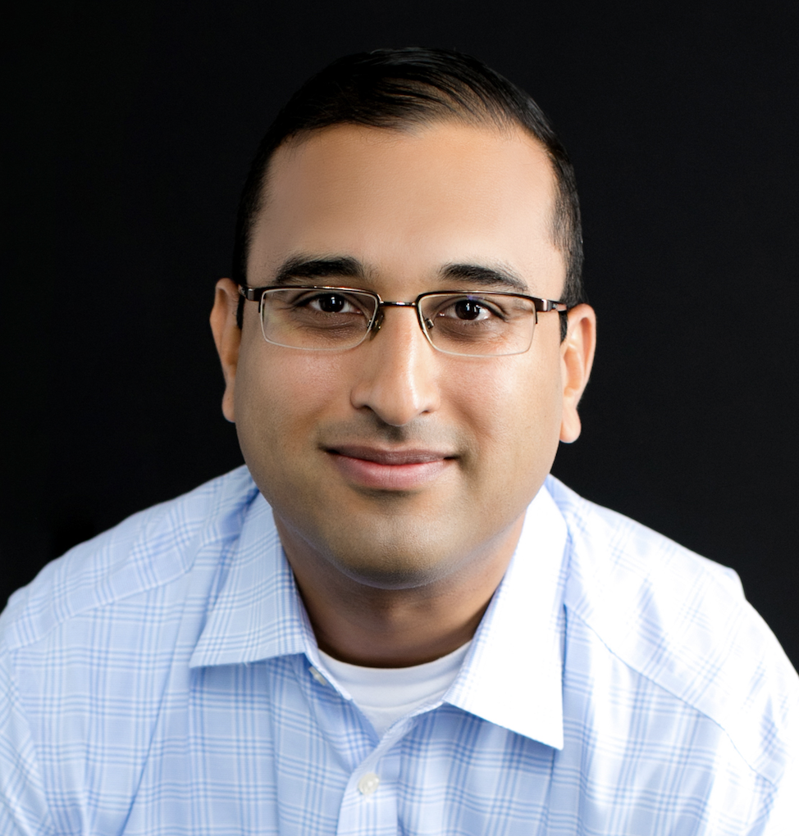
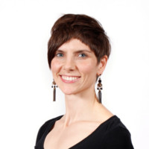
Critical thinking
Cherian Koshy (Endowment Partners LLC – USA)
Ashley Belanger (Ashley H. Belanger Consulting – USA)
  Rogare Council members
https://www.rogare.net/critical-fundraising

Slide 27
Critical thinking
Step 1: Understanding evidence
Do I need evidence to make a decision?
What type(s) or evidence to I need?
How do I know if my evidence is good evidence?

Slide 28
Critical thinking
Step 2: Testing evidence
How recently was this study published or conducted?
Does the evidence contradict itself, similar external data, or human experience?
What is the source of this evidence?
How was this study conducted or how were the results obtained?

Slide 29
Critical thinking
Step 3: Crafting and critiquing arguments. All arguments:
Begin with assumptions
Have an objective
Require relevant proof
Require reasoning to connect the premise to the proof to the conclusion
Have conclusions that have implications or consequences

Slide 30

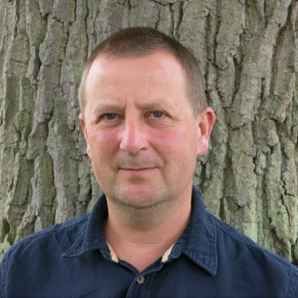
Critical thinking
Critical reviewing arguments (others’ and yours)
Comprehensible
Assessable
Defeasible
Interest-neutral
Compelling
  Julian Baggini

Slide 31
Rogare’s twin objectives
1. Develop a richer knowledge base
2. Change the culture of learning in fundraising.

Slide 32
Learning culture
Critical Fundraising Network
Theory of Change
Influence the Influencers
Co-creation of professional knowledge.

Slide 33
Theory of change
By enabling fundraisers to Ask the right questions about
Theory and
Evidence
through Critical thinking,
in a mode of enquiry we call Critical Fundraising,
we can establish a Network of critical thinkers in fundraising

Slide 34
Theory of change
that will engender a Culture of questioning, critique and criticism, in which, through informed debate we will Identify knowledge gaps by exploring
Under-researched issues (evidence), and
Under-thought issues (theory)
leading to Better theory and Better evidence
that will close Knowledge gaps,

Slide 35
Theory of change
and, by Influencing the influencers
Embed new knowledge and thinking in professional practice
resulting in a Change in the learning culture in how fundraisers use Theory and Evidence to tackle Professional challenges.

Slide 37
Critical Fundraising Network
Rogare Council
Knowledge Collectives
Research Projects
Research Centres
Will you become part of the Critical Fundraising Network?
https://www.rogare.net/join-the-cfr-network

Slide 39
Rogare Associate Members
Rogare is supported in our work by a number of Associate Members – partners to the fundraising sector that share our critical fundraising ethos. It is because of this support that we can make all our work freely available to the fundraising profession.

