Slide 1

Psychological well-being and the charitable bequest decision
Dr Lucy Lowthian

Slide 2
External trends
In 2007, legacy income was worth £1.7bn, in 20/21 this has nearly doubled to £3bn ​
1 in 3 baby boomers are putting a gift in their will​
58% of adults do not have a will in the UK
Only 6.3% of people in the UK include a charitable bequest
Notes:
I thought I would start by sharing a few of the external legacy trends in the UK. In 2007, legacy income was worth £1.7bn, in 20/21 this had nearly doubled to £3bn and this is set to double again by 2045. And this is thanks to more Will writing, a higher death rate and a greater inclusion of charitable gifts in Wills.
There is no denying that Coronavirus has caused more people to reflect on their mortality and plan for their death​ so this is an opportune time to raise awareness of legacy giving.
We are also at the cusp of the biggest - wealth transfer of all time thanks to the charitably minded baby boomer generation. Therefore, the coming years have long been predicted as an exceptional opportunity for legacy giving.
Despite this positive increase in legacy giving, challenges remain. According to unbiased.co.uk, around 58 per cent of adults do not have a Will and only 6.3 per cent of people in the UK include a charitable bequest (Smee & Ford).
This really highlights the vast amount of unrealised charitable legacy income which provides a real opportunity for future growth.

Slide 3
Making legacy giving meaningful
How do we make more people aware of legacy giving so they consider leaving a gift in their Will?
We need to understand how donors want to be approached about the subject, so it becomes a more meaningful experience
Making legacy communications more effective
Notes:
Although it is clear that more people need to be made aware of legacy giving, it is also important to understand how donors want to be approached about the subject, so that it becomes a more meaningful experience for them. Understanding legacy giving from the donor’s perspective can help ensure that any communications about charitable bequests are as effective as possible.

Slide 4
The legacy journey
Legacy enquirer – they have started thinking about their options and contacting charities for more information
Legacy considerer - considerers feel a sense of warmth towards a charity and have thought about who they might include in their Will
Legacy intender – intenders have considered their options and possibly discussed these with loved ones before deciding ‘yes, I would like to include x in my Will’
Legacy pledger – legacy pledgers have written their Will and let the charity know they have included a legacy gift to them
Notes:
We are told that potential legators pass through different stages of the legacy journey, two of which are consideration and intention. Yet little is known about what makes someone move from one stage to the next. For example, do certain psychological factors mediate (i.e. influence) the decision, which would provide us with a better understanding of the legacy decision making process?
The aim of my study was to bring theories about psychological well-being (PWB) into the legacy giving domain, to understand more about how a person’s PWB affects their charitable bequest decision, including how potential donors might pass from consideration to intention.

Slide 5
Research Methodology
Two successive online surveys were sent out to Christian Research’s online panel
The surveys were open to anyone aged 18 years or over and respondents supported a range of charitable causes
Over 2,100 respondents across both surveys
The first survey examined which psychological factors drive the charitable bequest decision and move a person from consideration to intent
The second survey used scenarios in order to prime low/high levels of certain psychological factors to see if different combinations of each affected a person’s intention to leave a gift in their Will
Notes:
To collect data for analysis, two successive online surveys were sent out to Christian Research’s online panel. The surveys were open to anyone aged 18 years or over and respondents supported a range of charitable causes to ensure this study’s findings could be applied to a wider population. The number of respondents across both surveys exceeded 2,100 providing a strong sample size from which to generate results.
The first survey examined which psychological factors drive the charitable bequest decision and move a person from consideration to intent in the legacy journey. The second survey then drilled down into some of the key findings from the first survey, using scenarios in order to prime low/high levels of certain psychological factors to see if different combinations of each affected a person’s intention to leave a gift in their Will.

Slide 6

Which psychological factors move supporters on in their legacy journey?
Connectedness
Self-efficacy
Identity importance
Sense of purpose
Notes:
Results from the first study have shown that we can increase a person’s intention to include a gift to charity in their Will if we can enhance their feelings of connectedness, self-efficacy, identity importance or sense of purpose in relation to the cause. I will discuss these factors in more detail below.

Slide 7

Connectedness
Connectedness can be described as the closeness or intimacy a person feels in their relationships with others
People build these relationships over their lifetime
People forge strong relationships with charitable causes if they, or someone they love, have in some way benefitted from its work
Building connectedness should be at the heart of charities’ communications
We need to connect on an emotional level – using case studies can be powerful
Connecting supporters directly with beneficiaries creates a personal bond
Notes:
Connectedness was shown to be a significant psychological factor; the more connected a person is to a charity, the more intent they will be to include them in their Will. Connectedness can be described as the closeness or intimacy a person feels in their relationships with others. A person builds these relationships over their lifetime and they can forge strong relationships with charitable causes if they, or someone they love, have in some way benefitted from its work.
Building connectedness should be at the heart of charities’ communications with their supporters. For example, we know stories connect on an emotional level, so using donor case studies is a powerful way to motivate people to leave a charitable bequest. Connecting supporters with beneficiaries creates a personal bond; supporters can envisage who they are helping.

Slide 8
Self-efficacy
Self-efficacy is a person’s belief that they can achieve their desired outcomes and make a difference
Self-efficacy empowers people because they believe they can have a positive impact
Charities need to show the ways a person’s legacy gift can make a difference to beneficiaries in order to increase legacy income
Higher levels of self-efficacy significantly increase the likelihood that someone will include a charitable bequest in their Will
Notes:
Self-efficacy is a person’s strong belief that they can achieve their desired outcomes and make a difference by focusing on their longer-term goals (Bandura 1997). Self-efficacy is not purely concerned with immediate outcomes; it’s about the persistence needed from beginning to end, looking at the long-term goals of the task (Rodgers, Markland, Selzler, Murray and Wilson 2014).
Although there is relatively little research with regards to self-efficacy and charitable giving, self-efficacy appears to motivate people when they are writing their will, to focus on the future of charitable causes and the positive impact their gift can have to the charity’s work and its beneficiaries. As I found in my research, higher levels of self-efficacy significantly increase the likelihood that someone will include a charitable bequest in their will.

Slide 9
Greater purpose in life
People who understand their life’s purpose tend to be more optimistic, well connected and happier individuals who are more engaged with life
Can be associated with getting older as people have had the time to experience more, so they have more meaningful memories
Leaving a charitable bequest encourages a person to think about their life and what is important to them
There is also a greater sense of meaning in the act of leaving a charitable bequest - it provides a way for people to make a difference after they are gone enhancing a person’s purpose in life
It is becoming more important for charities to have compassionate conversations that are considered meaningful with their supporters - focusing on what is important in life (and after death) to a person
Notes:
Greater purpose in life was also shown to have a significant effect on the charitable bequest decision. People who understand their life’s purpose tend to be more optimistic, well connected and happier individuals who are more engaged with life. Purpose in life is also positively associated with getting older; this is because people have had the time to experience more, so they have more meaningful memories and a longer life narrative.
Leaving a bequest in a Will to charity encourages a person to think about their life and what matters to them. For example, a beneficiary or volunteer may want to give something back to a charity that has been an important part of their life. There is also a greater sense of meaning in the act of leaving a charitable bequest in a Will because it provides a way for people to make a difference after they are gone, enhancing that person’s ultimate purpose in life. Their legacy will live on and benefit future generations, which is an incredibly positive way to be remembered.

Slide 10
Identity importance
Every person has distinct identities, and they place a level of importance on each role they undertake
Identity grows stronger over time as people perform more in the role and develop a sense of belonging
For example, if a person has been a charity volunteer or supporter, this could have a positive impact on their desire to include a charitable bequest because of the importance they place on the role
Higher identity importance strengthens the relationship between consideration, connectedness, and intention, positively impacting on the charitable bequest decision
In contrast, when identity importance is low, self-efficacy mediates the relationship between consideration of a charitable bequest and intention
Notes:
Role identity provides people with a sense of purpose, so they know what is expected of them in certain situations. Identity grows stronger over time, as people develop a sense of belonging. For example, if a person has long been a charity volunteer or supporter, this could have a positive impact on their desire to include a charitable bequest, because of the importance they place on that role. Their connection with the charity has more than likely strengthened over time through the relationships they forge, impacting on their loyalty and sense of identity with the cause.
My findings have shown that when identity importance is high, it strengthens the relationship between consideration, connectedness and intention, positively impacting on the charitable bequest decision. If a person strongly identifies with a charity, it strengthens their feeling of connectedness with the charity and its beneficiaries. In contrast, when identity importance is low, self-efficacy mediates the relationship between consideration of a charitable bequest and intention. This suggests that people need to focus on the positive outcomes of their legacy gift and the difference it will make if they do not strongly identify with the charity.
Therefore, ensuring supporters identify with the cause should be a priority for charitable organisations as well as providing them with opportunities to be personally involved. This highlights the importance of excellent supporter journeys so that charities have clear plans about how they will steward supporters in a way that builds loyalty and keeps them engaged with the charity’s work.

Slide 11
Focusing on others
The results showed that if people feel a deep connection with the charity and they identify strongly with the charity and its work, and they believe their gift will make a difference, they are more likely to include a charitable bequest in their Will. But at the same time, for that gift to materialise, they must also be more ‘other- focused’.
However, if a supporter does not understand the difference their gift can make, but they still have a deep connection with the charity and they identify strongly with the charity and its work, the decision to include a charitable bequest in their Will is then mediated by ‘interdependent self-construal’.
Notes:
The second phase of the study examined the relationships between connectedness, self-efficacy, identity importance and intention to leave a charitable bequest a will with ‘self-other focus’ and ‘interdependent self-construal’ as the mediators.
The results showed that if people feel a deep connection with the charity and they identify strongly with the charity and its work, and they believe their gift will make a difference, they are more likely to include a charitable bequest in their Will. But at the same time, for that gift to materialise, they must also be more ‘other- focused’. This suggests that another important element of the charitable bequest decision is a person’s willingness to put others’ needs before their own in the belief they can make a transformational difference to their lives.
However, if a supporter does not understand the difference their gift can make, but they still have a deep connection with the charity and they identify strongly with the charity and its work, the decision to include a charitable bequest their Will is then mediated by ‘interdependent self-construal’. In an interdependent relationship a person will look to others to guide their behaviour, which links to the concept of social norming, so the act of including a charitable bequest becomes accepted behaviour.

Slide 12
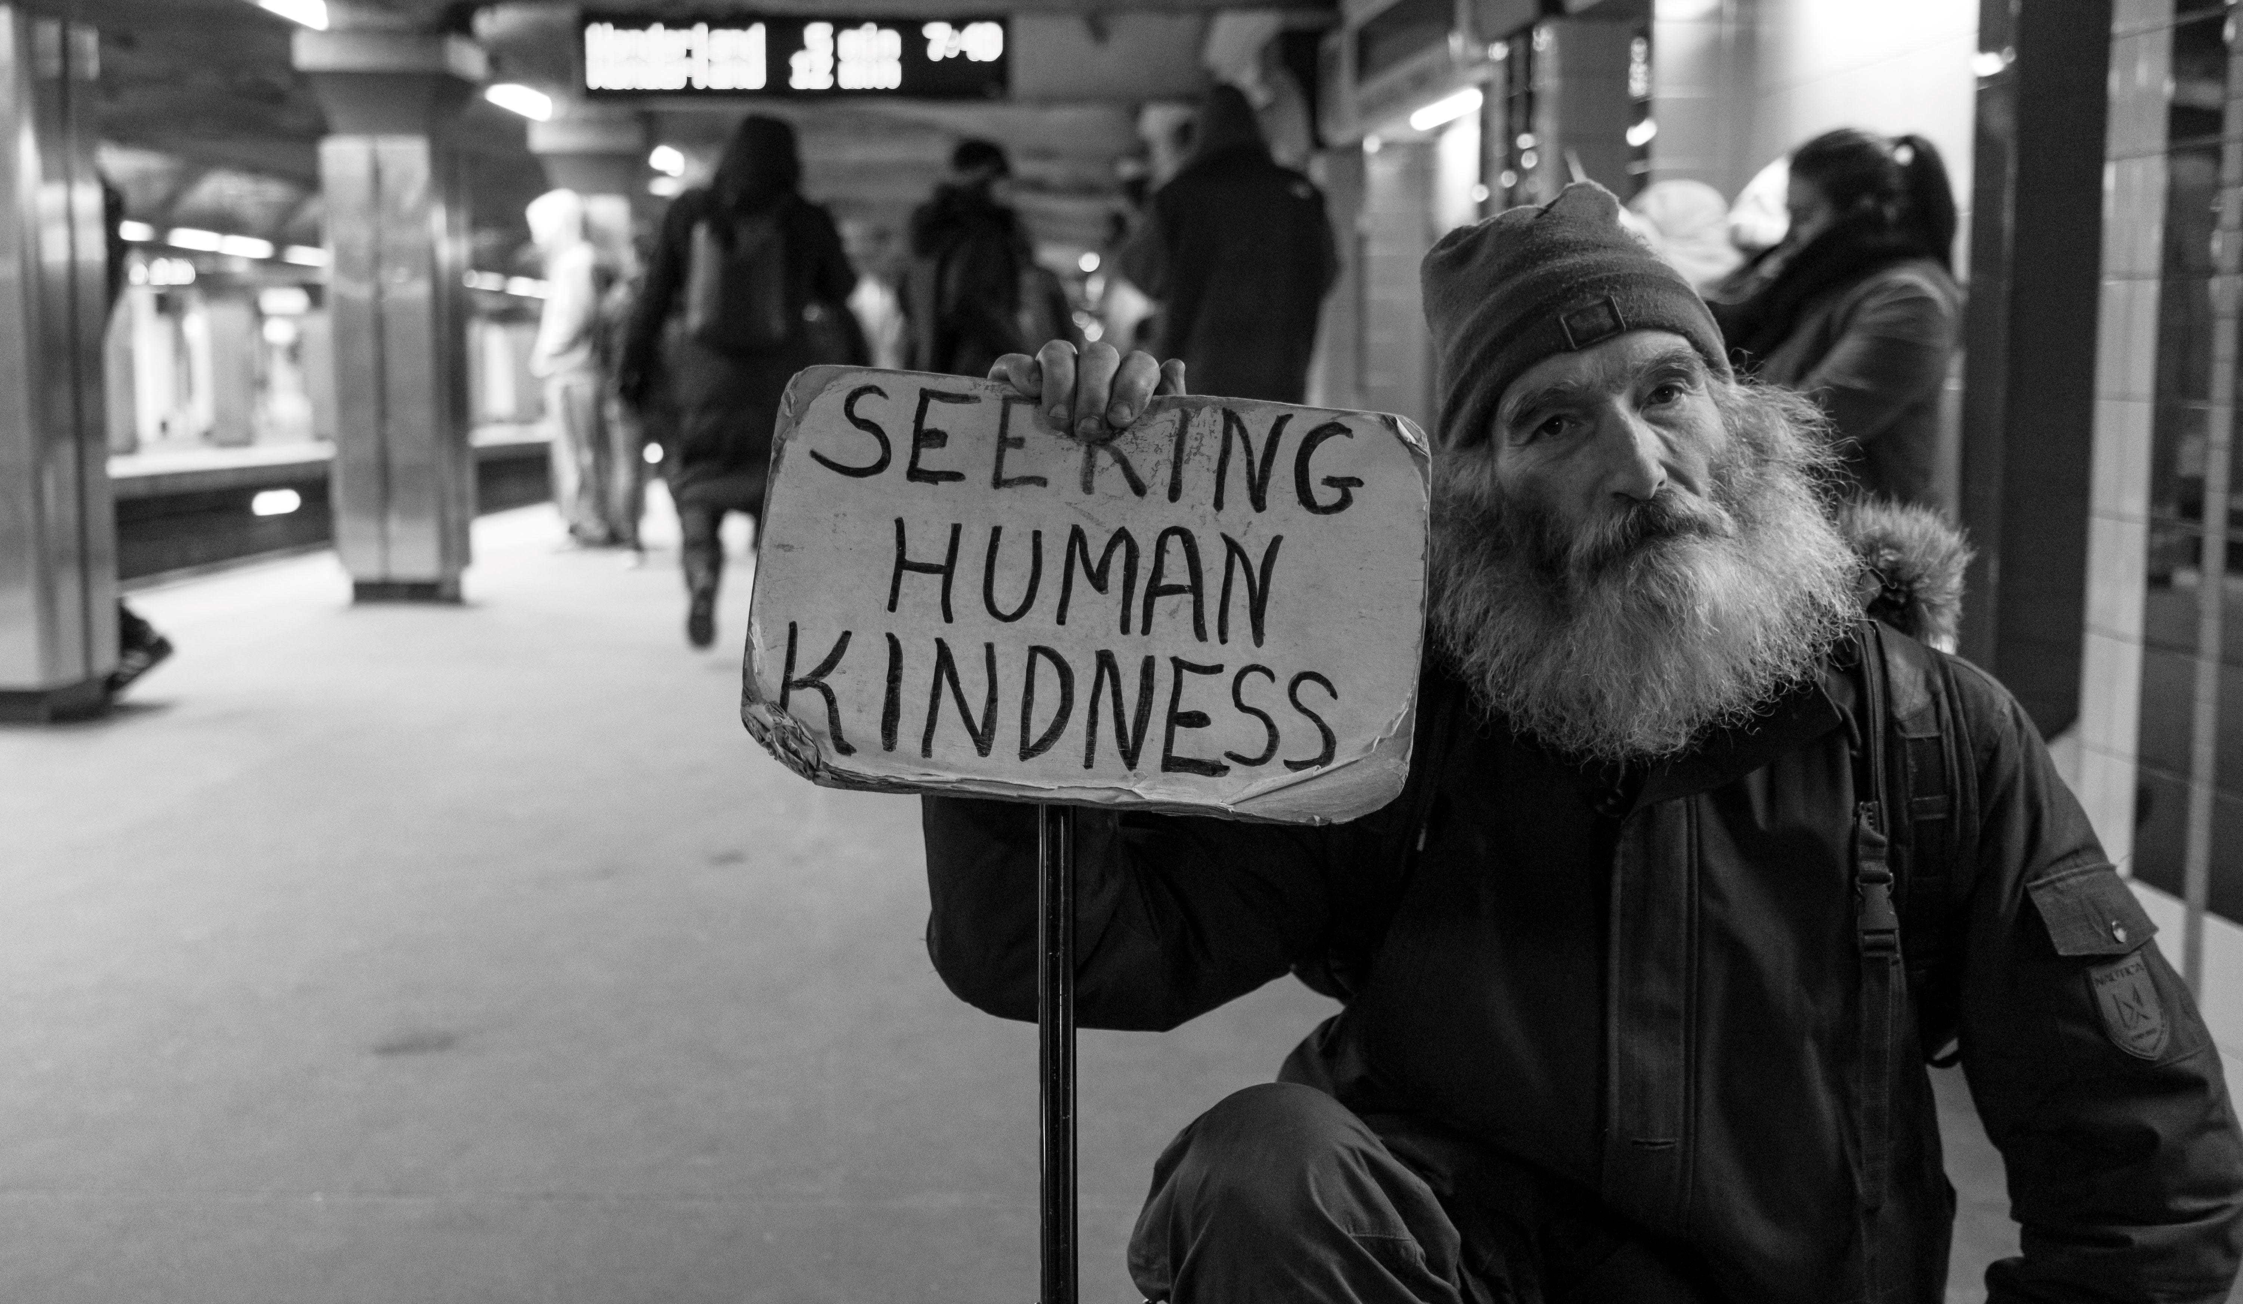
Help to create a social norm
Notes:
It is therefore important for charities – and the sector as a whole – to make supporters believe this is a common act; a social norm. Case studies of legacy pledgers can encourage supporters in their decision making when considering leaving a charitable bequest. Some charities might form pledger societies or organise legacy events as a way to normalise legacy giving amongst supporters. This study has found that people will look to others if they do not understand the impact of their gift so showing others who have pledged (or previously left) a charitable bequest is extremely important.

Slide 13
Notes:
These two alternative routes through the legacy decision are illustrated in the flow diagram on the slide.

Slide 14
The role of solicitors and will writers in prompting gifts
Solicitors and Will writers are best placed to prompt clients about legacy giving
We now have a better understanding of the most effective ways to prime people about charitable bequests
A person needs to focus on the causes they feel connected to and can identify with; they want to believe their gift will make a positive and lasting impact on the lives of others.
An example script could be - ‘Many people decide to leave a gift in their Will to a charity that is important in their life. Is there a charity you feel particularly connected to that you would like to include in your Will, so your gift can make a lasting difference in the future?’
Notes:
Solicitors and Will writers are often best placed to prompt clients about legacy giving in order to increase the number of charitable bequests included in Wills. I hope that the findings of this study suggests effective ways to prime people about legacy giving. For example, prompting the initial consideration of a charitable bequest is incredibly important but understanding which psychological factors drive the decision could make the prompt more successful. A person needs to focus on the causes they feel connected to and can identify with; they want to believe their gift will make a positive and lasting impact on the lives of others. An example script is shown on screen.
Gaining deeper insight into the psychology behind legacy giving can help to make the act of including a charitable bequest in a will a positive experience. Solicitors and Will writers may help generate even more gifts in Wills for good causes by linking the legacy prompt directly to the psychological factors which drive the charitable bequest decision – benefiting us all.

Slide 15




Rogare Associate Members
Rogare is supported in our work by a number of Associate Members – partners to the fundraising sector that share our critical fundraising ethos. It is because of this support that we can make all our work freely available to the fundraising profession.

